Slide 1
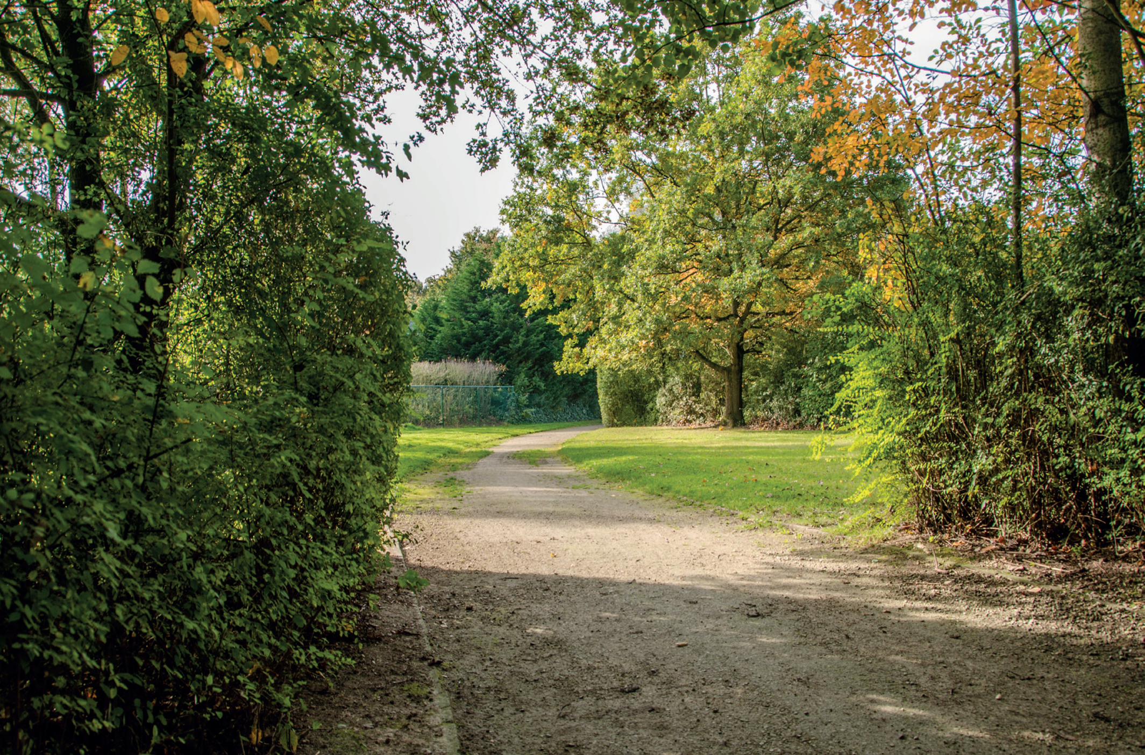





Het Zeen
Building green infrastructure together
Participation, a necessary tool for green-blue implementation in urban areas
Ingrid Holemans, mayor of Zaventem
Luc Vander Elst, project manager VLM

Slide 2
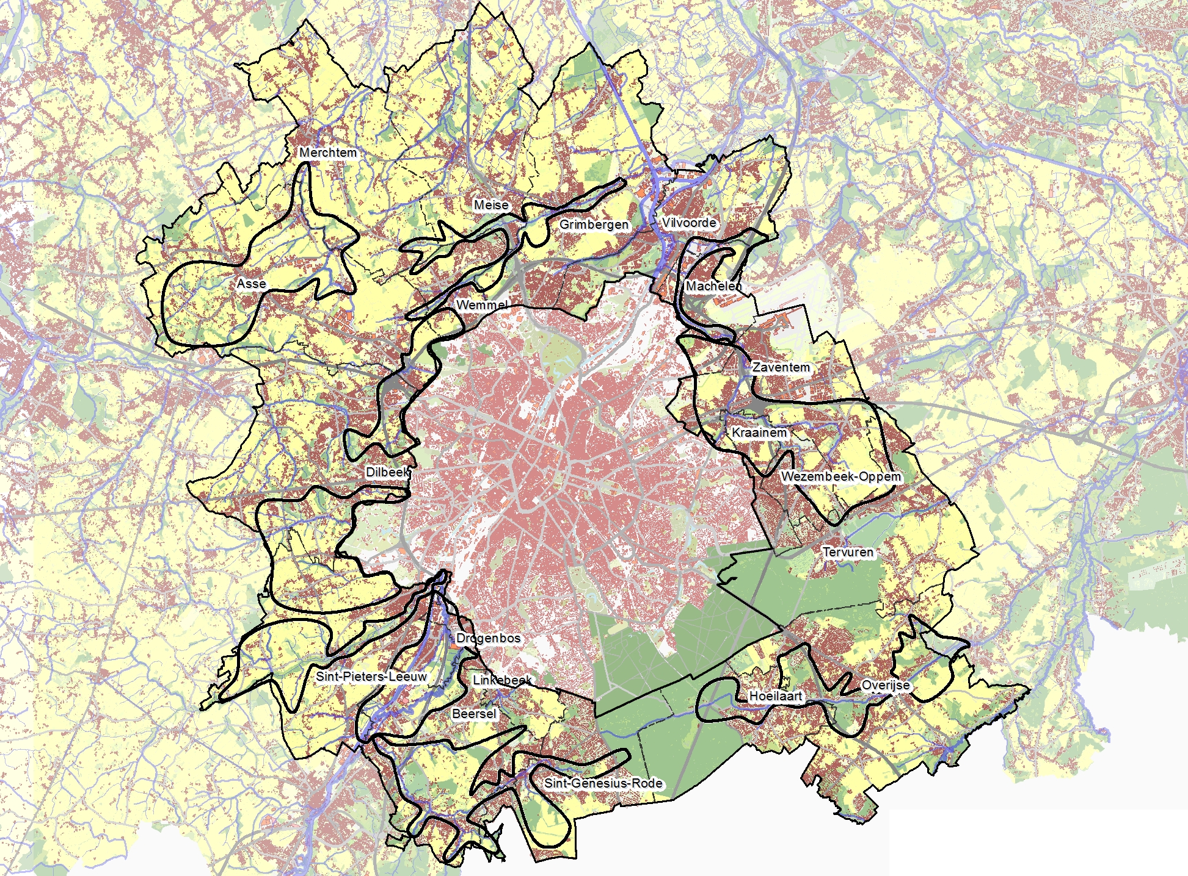
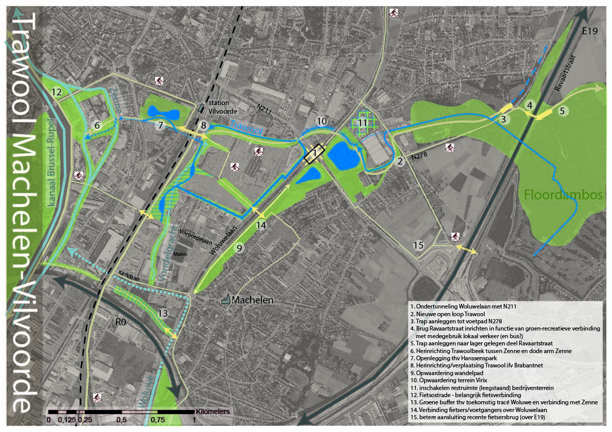
Notes:
In the 19 municipalities around Brussels in 2014 the Flemish government decided to install a project of land management. The goal was to connect open spaces and to reinforce them for more and stronger blue-green connections, a better living environment and more opportunities for nature, ecology, agriculture, landscape, heritage, mobility, recreation, etc. The Flemish Land Agency started to think about planning.

Slide 3
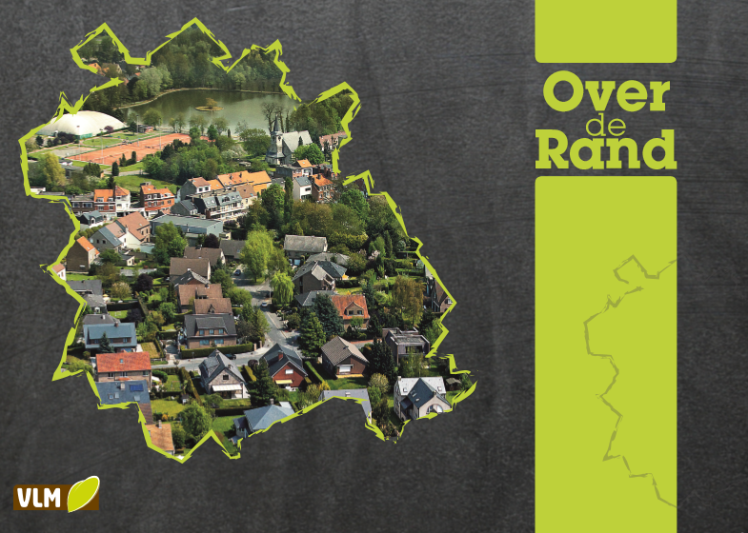
Notes:
A master plan was being conceived and written.

Slide 4
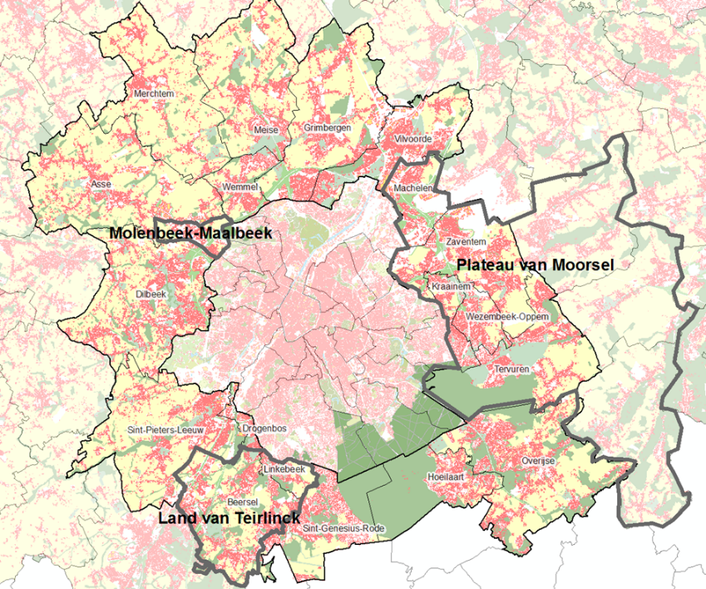
Notes:
And refined.

Slide 5
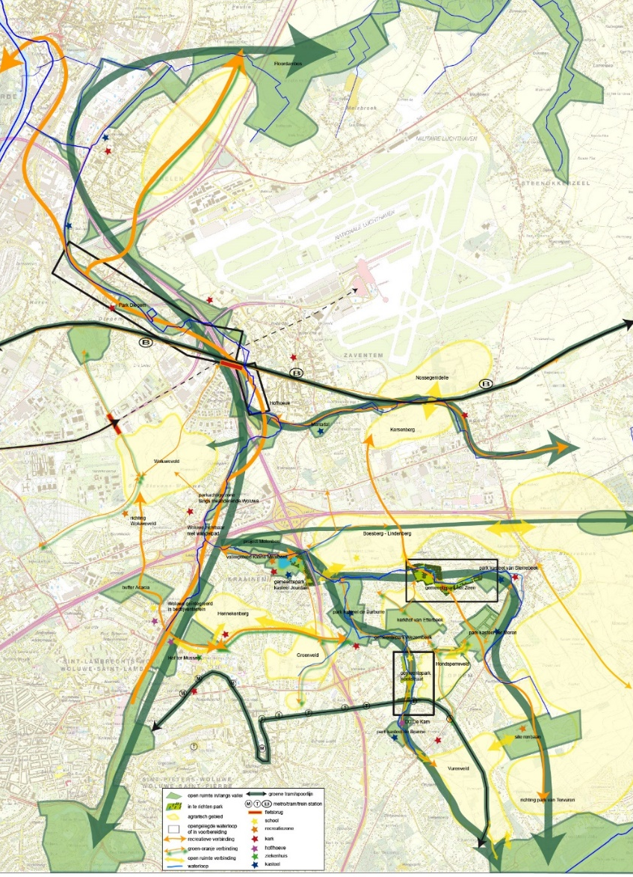

Notes:
And refined.

Slide 6

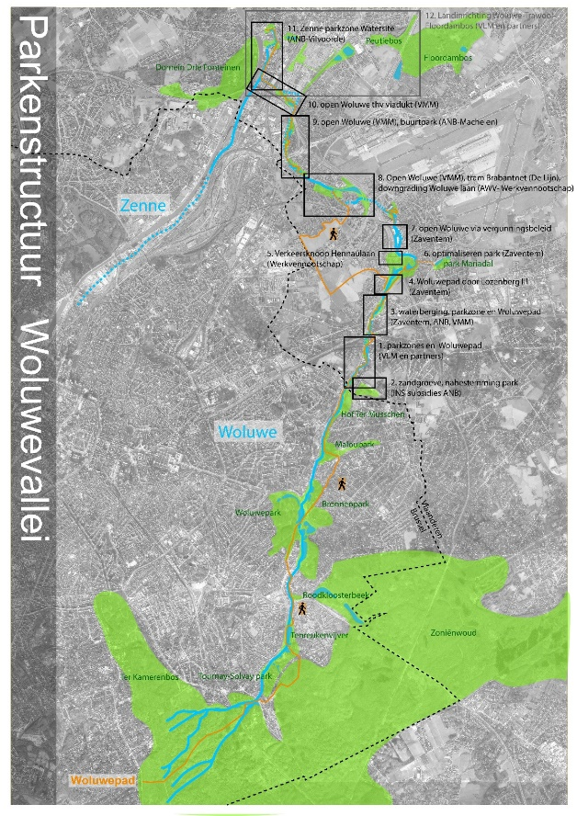
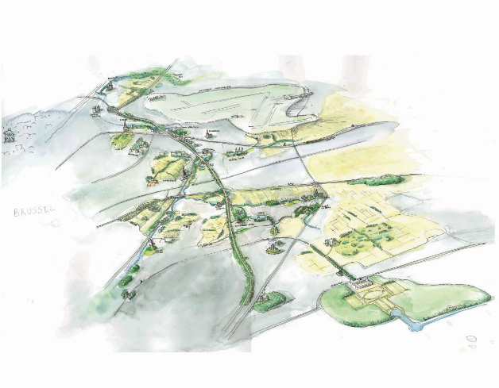
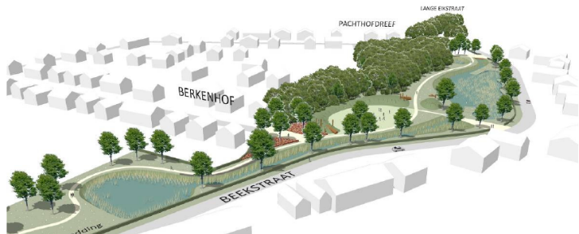
Notes:
Plans were refined and refined and became master plans on a smaller scale. During the preparation of these plans lots of partners had been consulted very frequently: municipalities, the province, other Flemish organisations, midfield organisations, etc. Before making a definite plan, it was time to consult the inhabitants. A point in the process not every municipality is keen on. Zaventem however, had its own vision on creating participation.

Slide 7

Notes:
For the park Het Zeen, we had several options. But also: the park and its surroundings had several functions. There were tennis and football fields. There was a skate park, a youth club, a youth association and a lot of housing in the immediate neighbourhood.

Slide 8
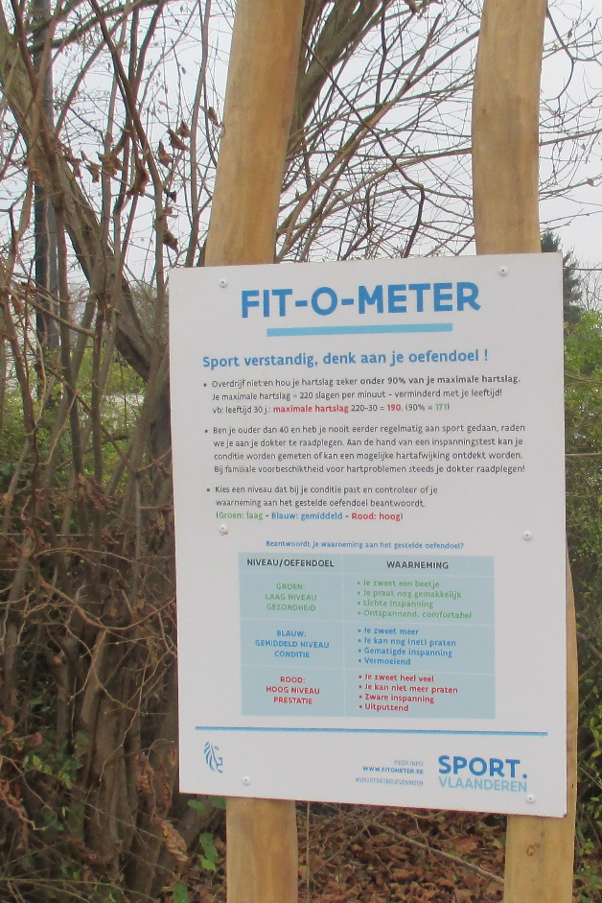
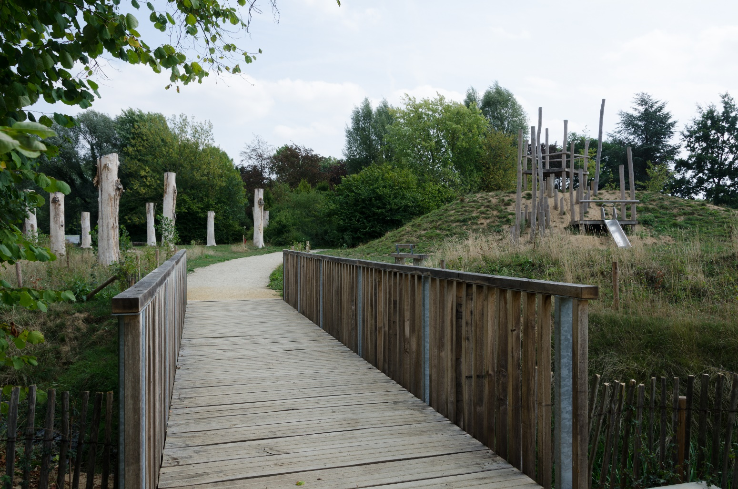
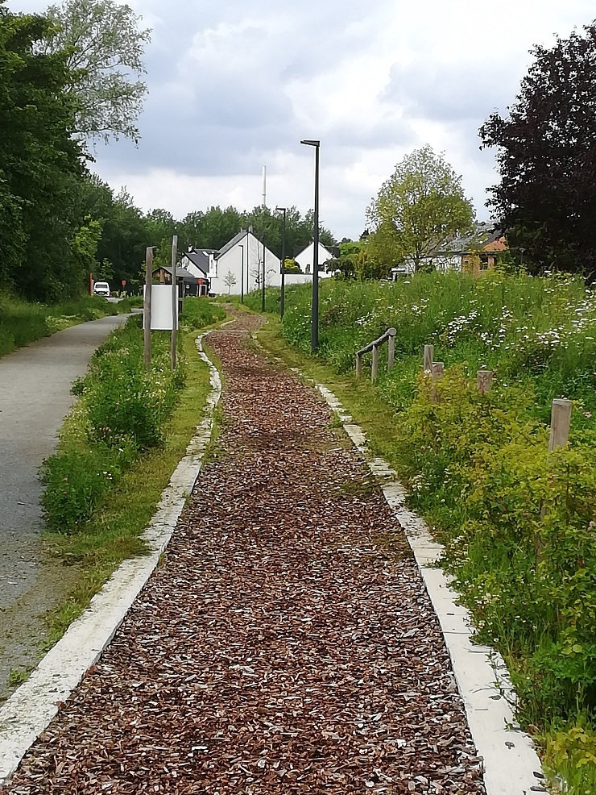
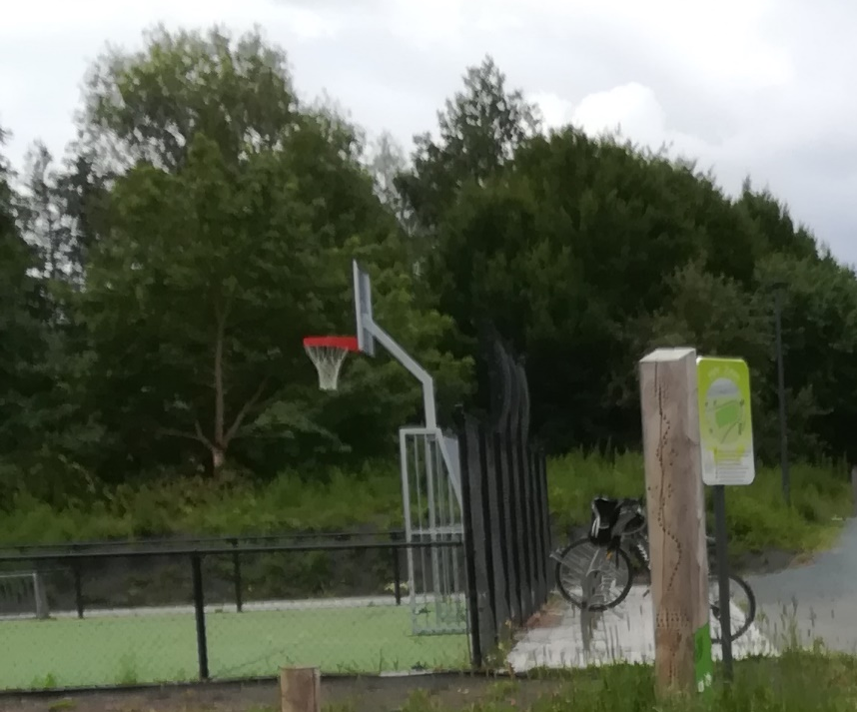
Notes:
During the meetings with our partners the plan was already finetuned a lot. The municipality for instance wanted a possibility to walk through the whole park, a running path, fitness elements and a little sports ground. But together with the municipality, we went further.

Slide 9
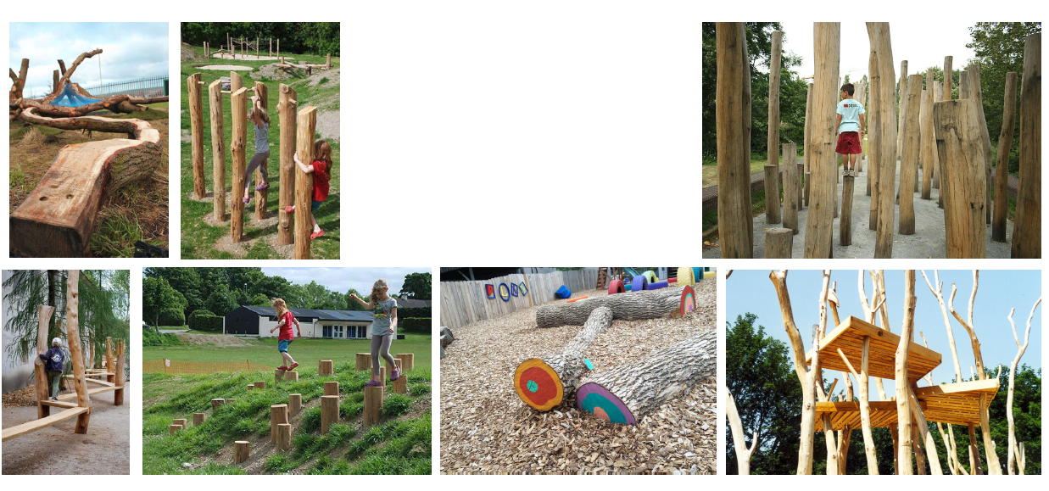
Notes:
For the playgrounds the Flemish Land Agency consulted the local school and asked the children what kind of playground they preferred. Therefore they used examples, drawings and pictures. So it would be easier for the children to choose.

Slide 10
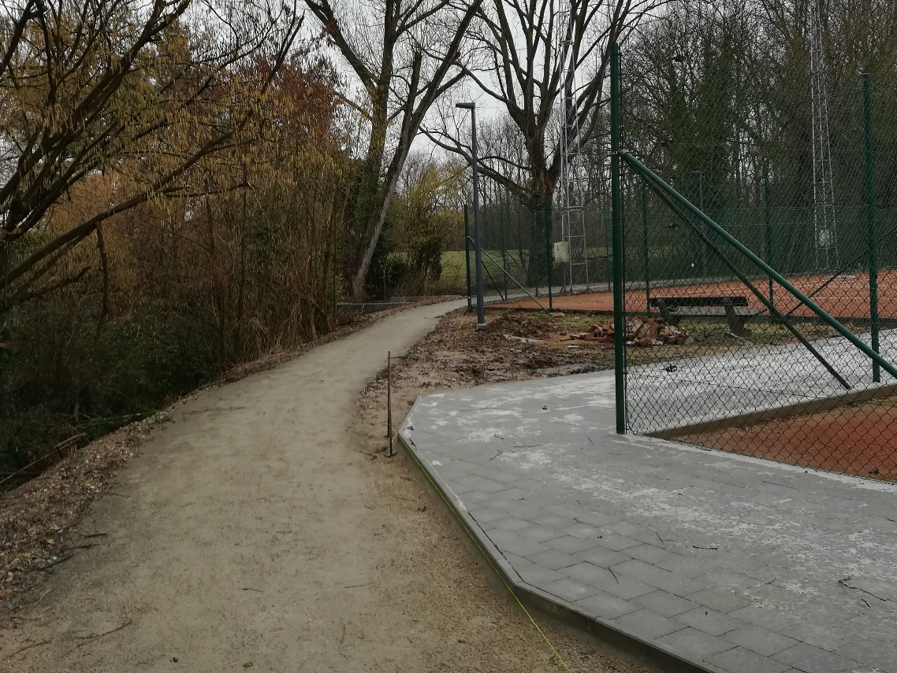
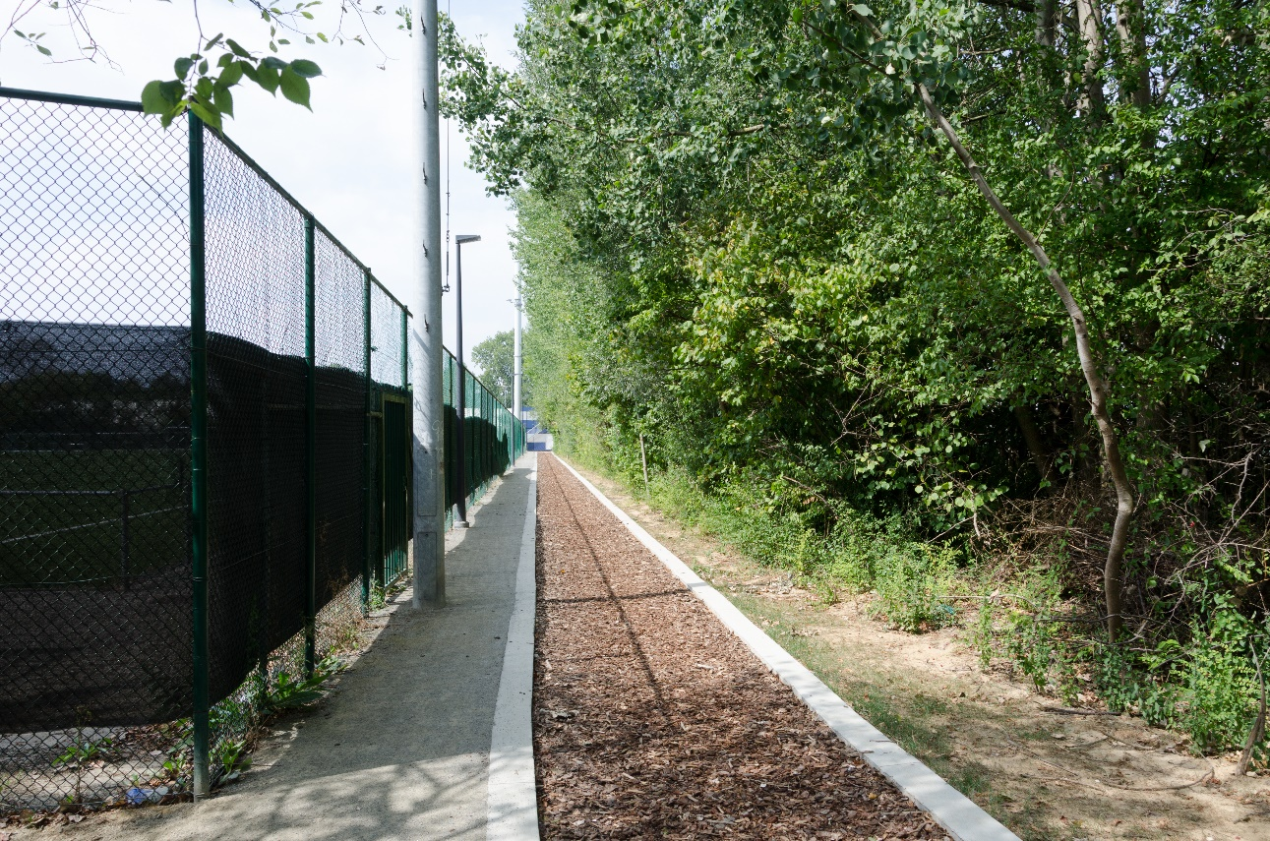
Notes:
Also with the associations in ‘Het Zeen’ agreements were made about passing through, common use, etc.

Slide 11
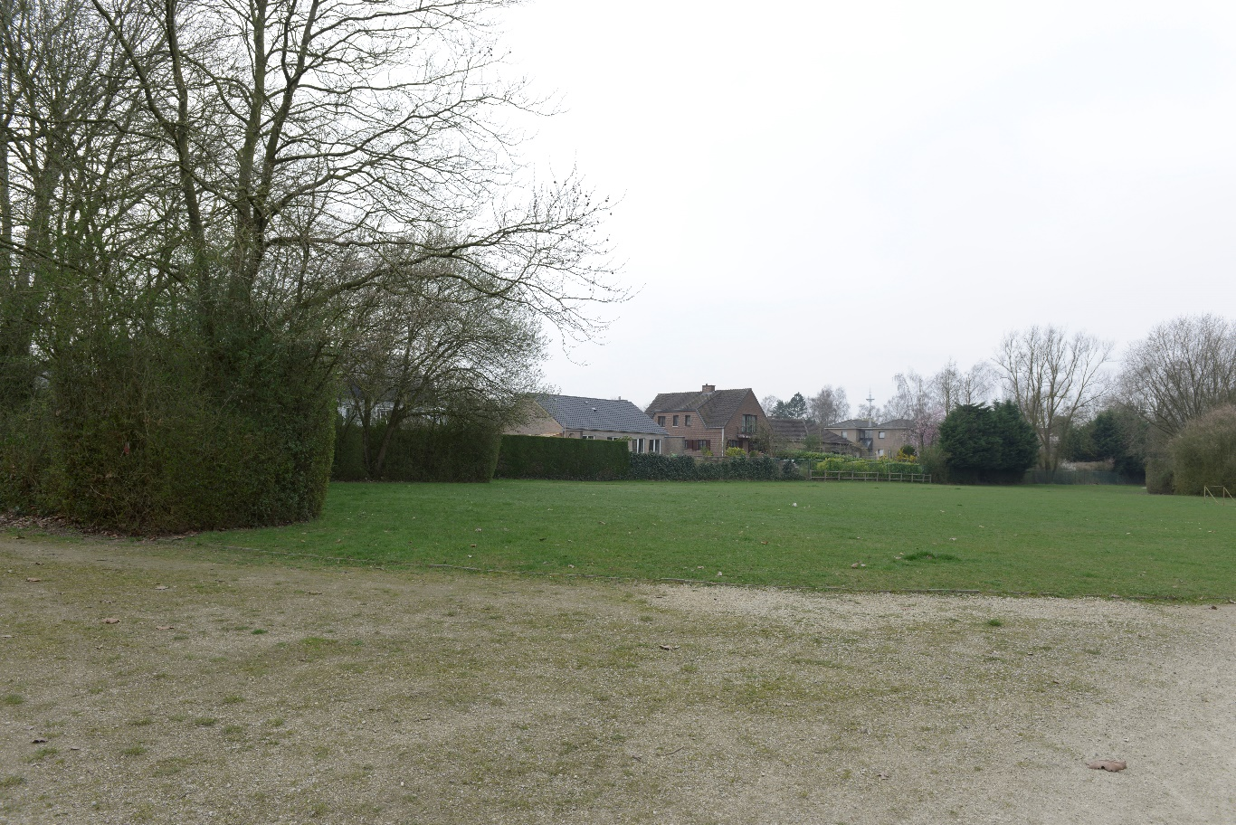
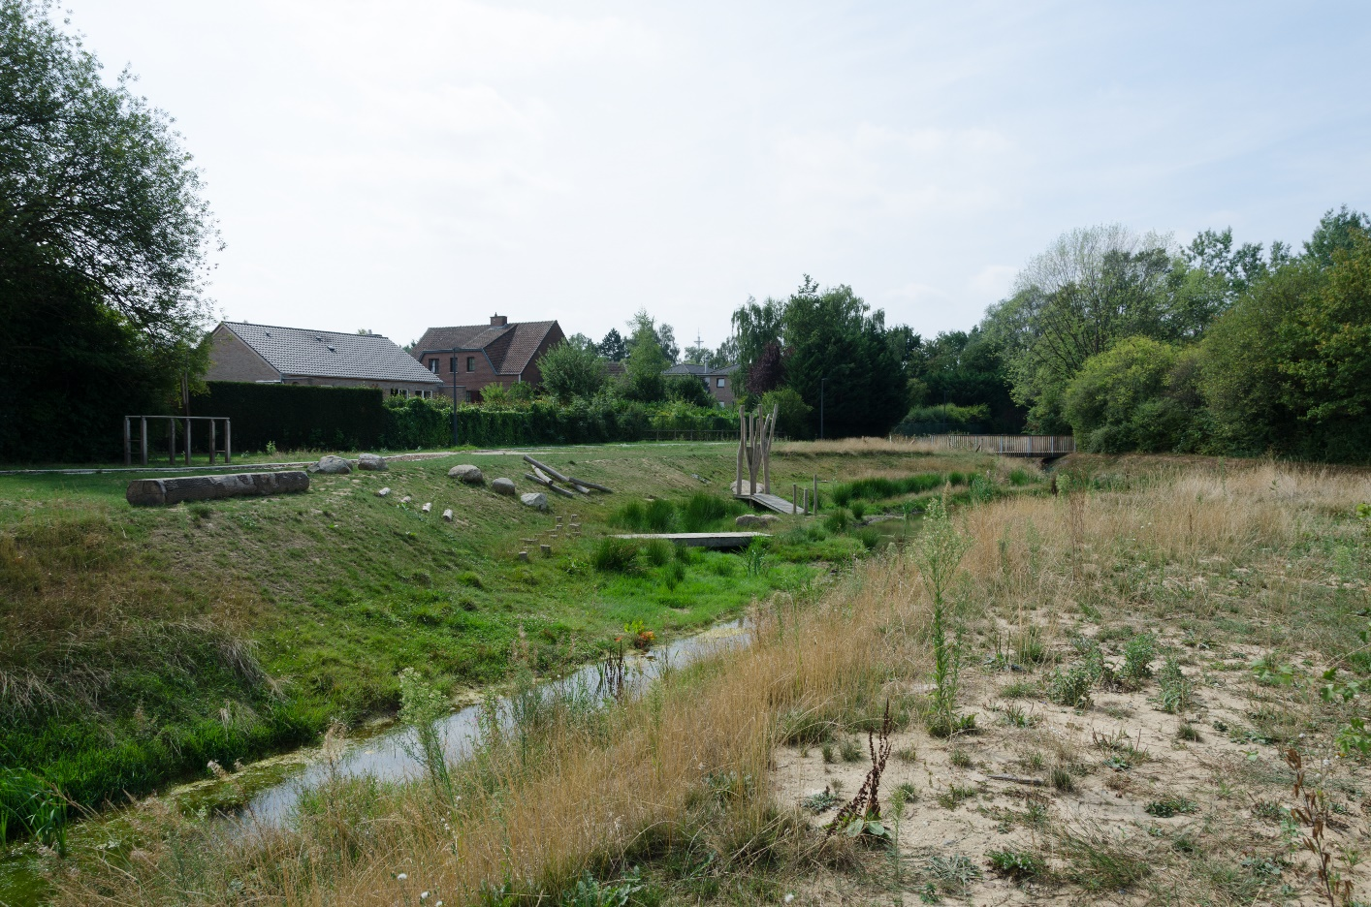
Notes:
But we knew that, if we wanted to go from the original view (above) to the new park (below)

Slide 12
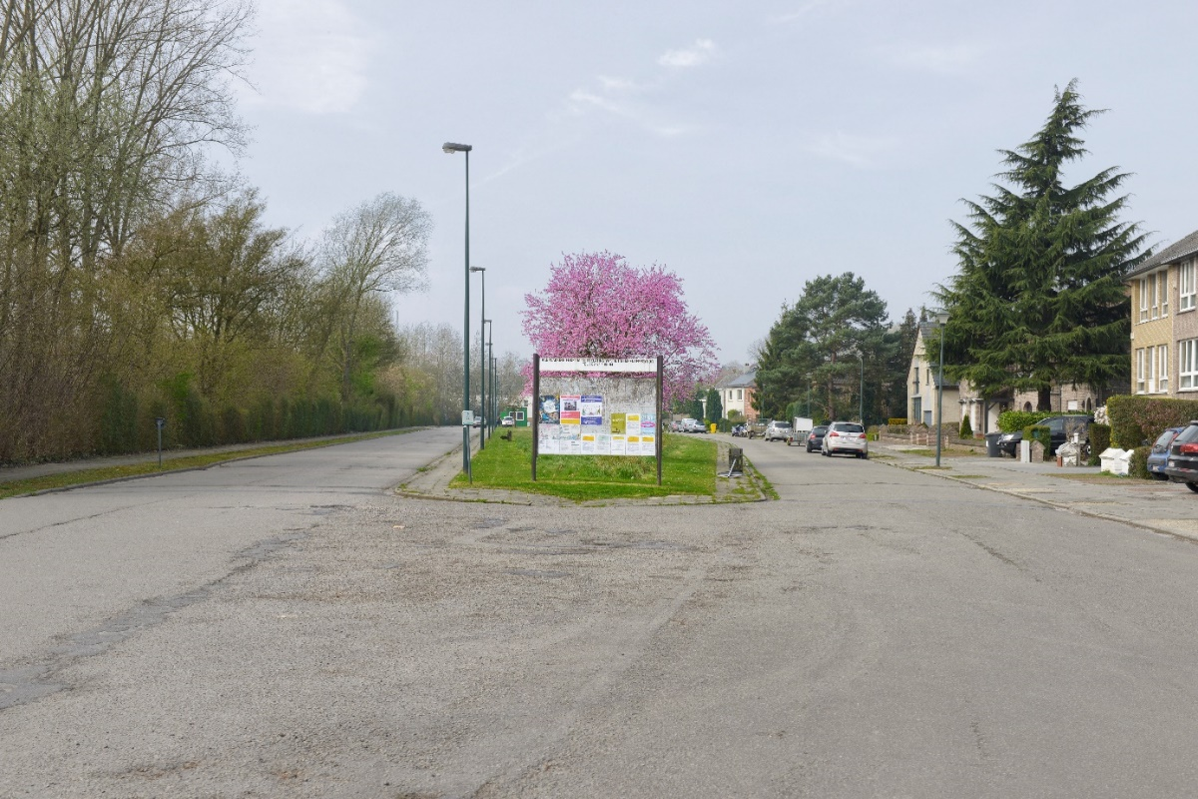
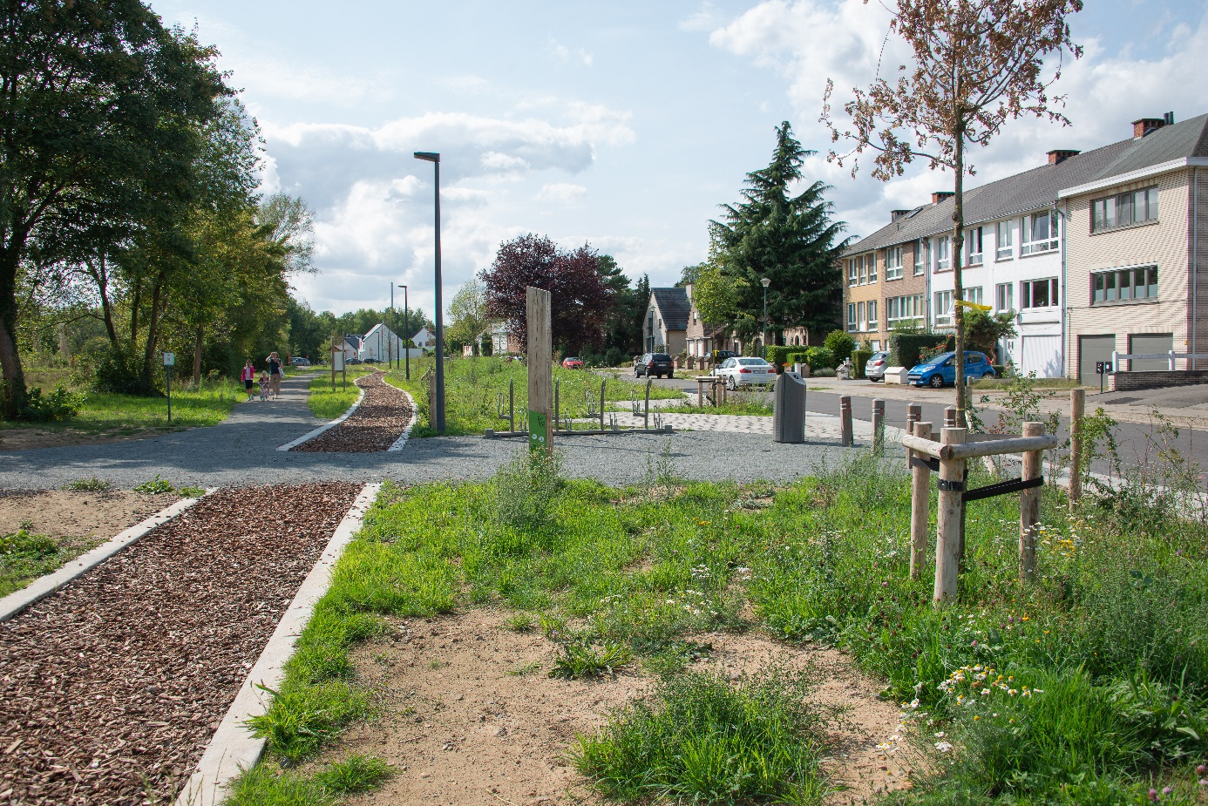
Notes:
Or from this view of an oversized road to the park view below, we would have to create a diaologue with our inhabitants. Because we wanted to have at least some form of conscent about all measures.

Slide 13
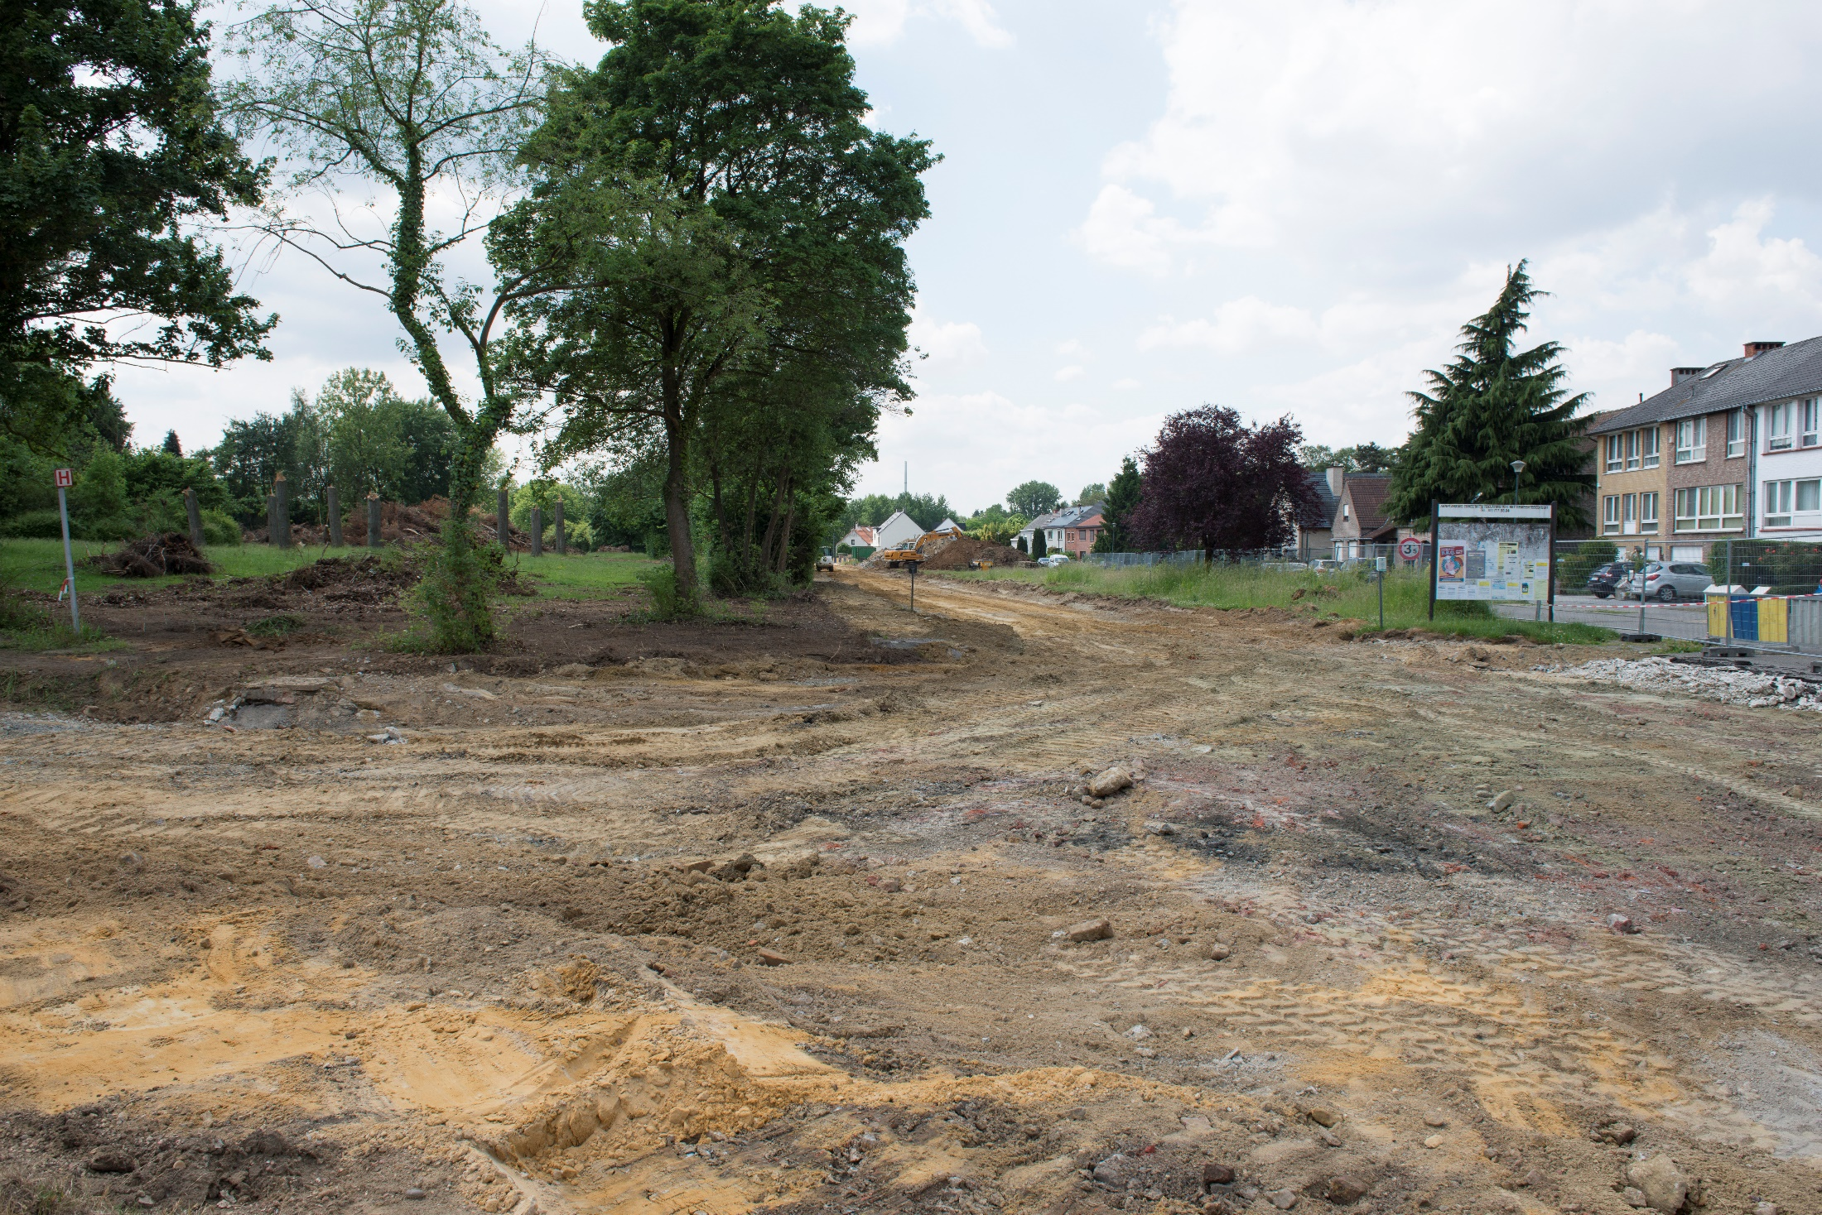
Notes:
One more reason: we also knew that we had to go through a period of works. That always enhances some extra problems for the local population. And mostly it is not very much fun for those living in the neighbourhood.

Slide 14
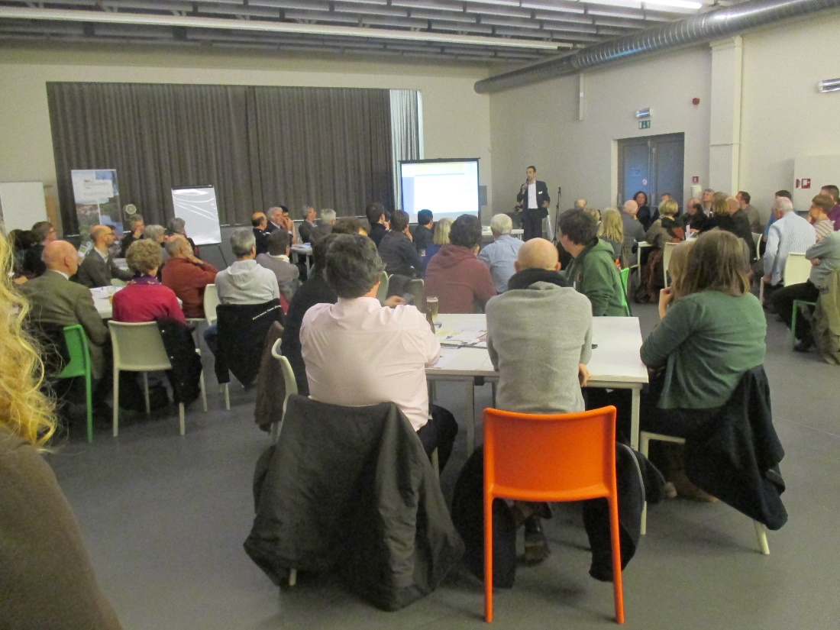
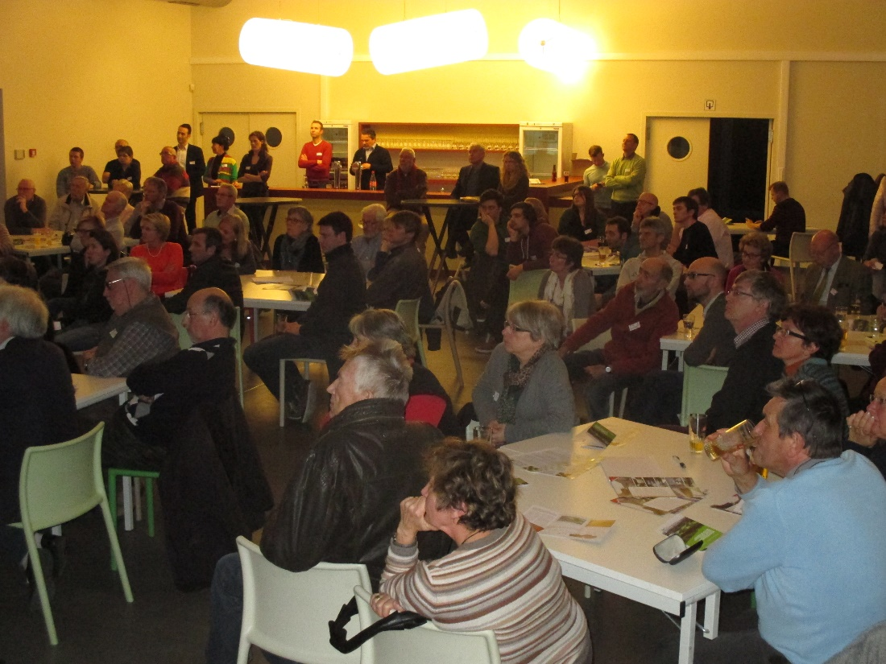
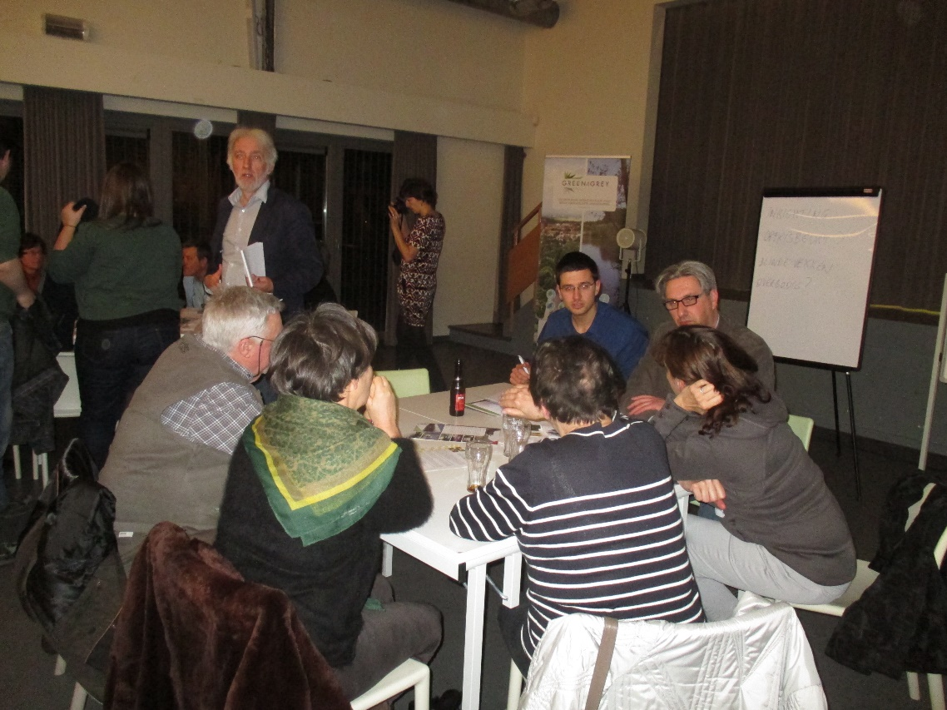
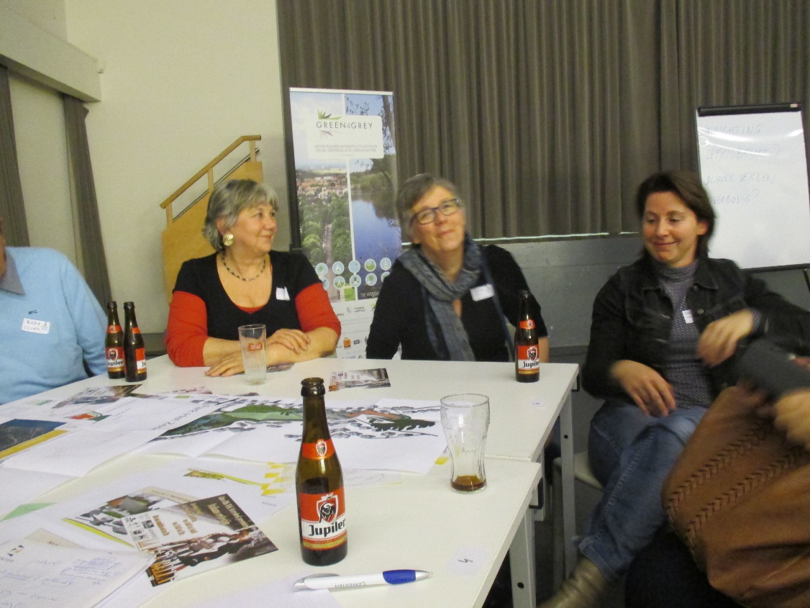
Notes:
Therefore we organised, together with the Flemish Land Agency, three moments of intense interaction with our inhabitants. The first one was the most decisive one.

Slide 15
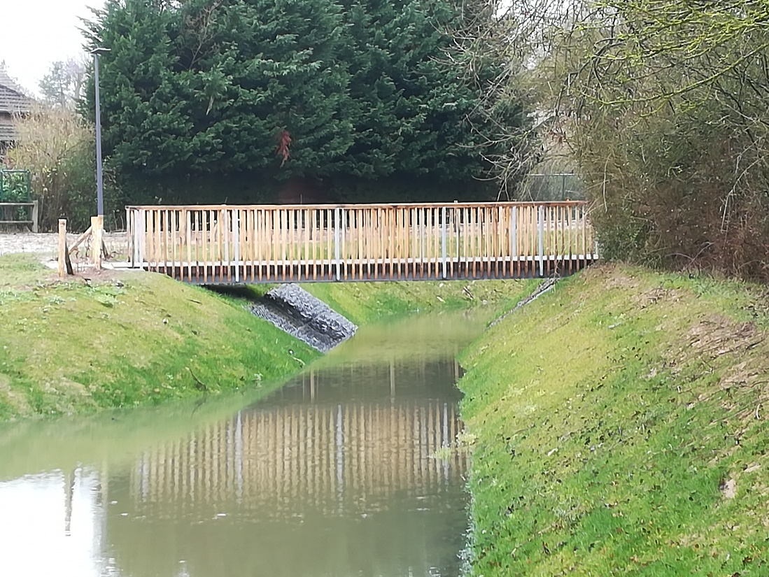
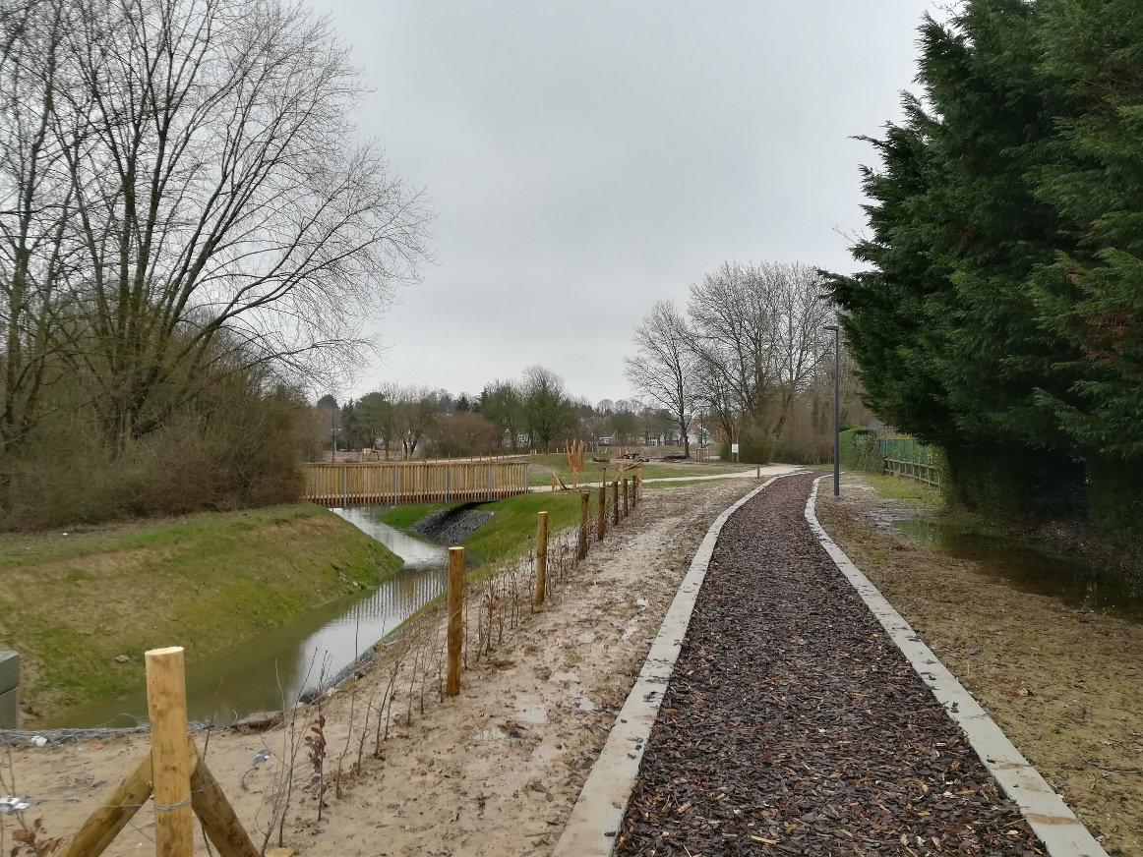
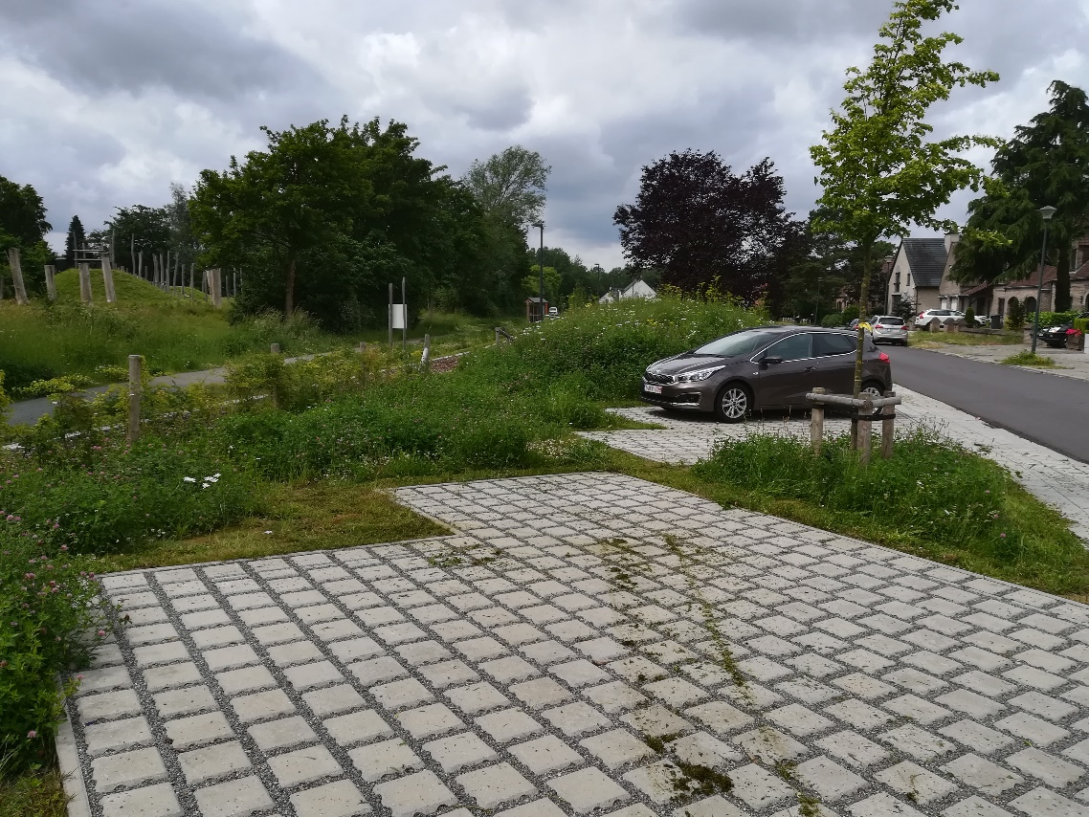
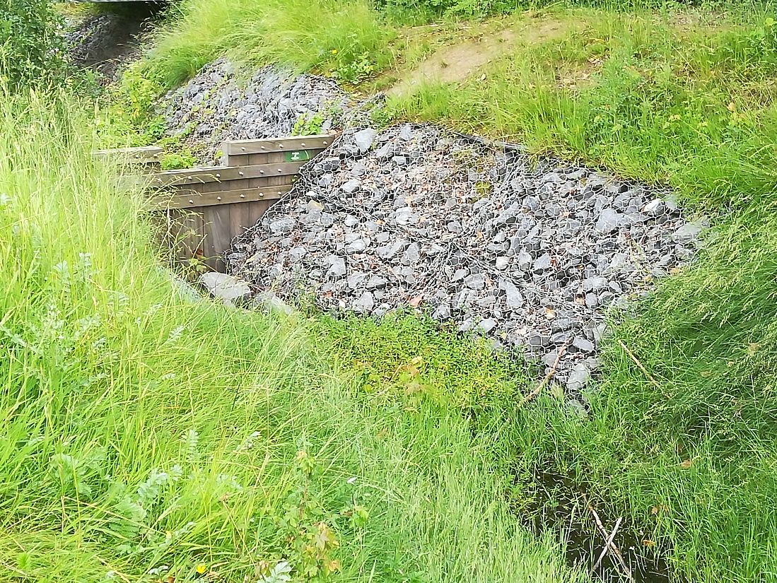
Notes:
A lot of concerns were discussed that first evening. Safety, for instance, or parking possibilities, or water management. All concerns were translated into the planning. But that evening, our inhabitants also had the opportunity to decide whether a street that cut the park in two, would have to disappear.

Slide 16
1
2
3
Notes:
All evening long people received information and could discuss about opportunities, problems and possible alternative solutions. After the break we organised a workshop about the road that cut the park in two. In eight groups our inhabitants discussed three possible alternatives. The first option was to keep the road as it was. That would also mean that the car traffic through the park would be maintained. In the second option the road would disappear completely. There would only be a possibility for bikers and pedestrians to go through the park and the park would gain in space. The third option was to slow down traffic by the usual overall known measures. To our surprise seven of the eight groups chose for option two. So, the road has disappeared now and the passage for bikers and pedestrians is now completely safe.

Slide 17
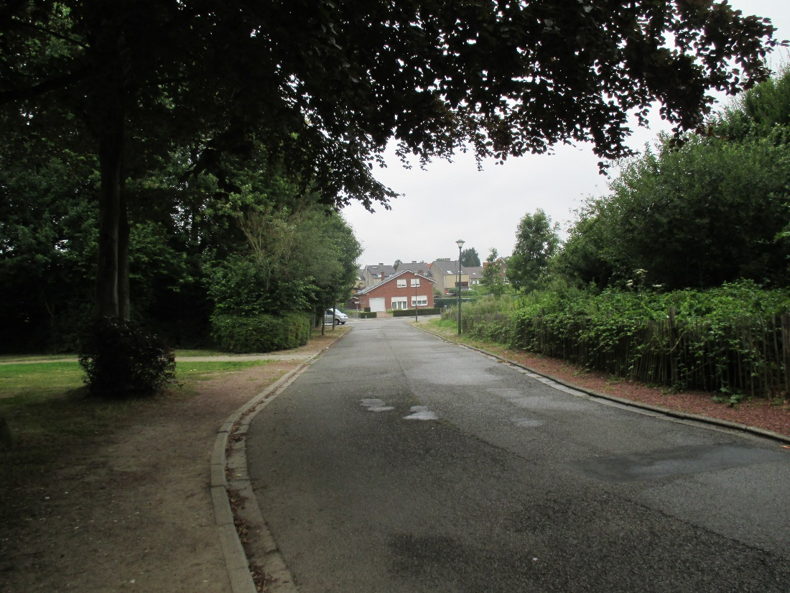
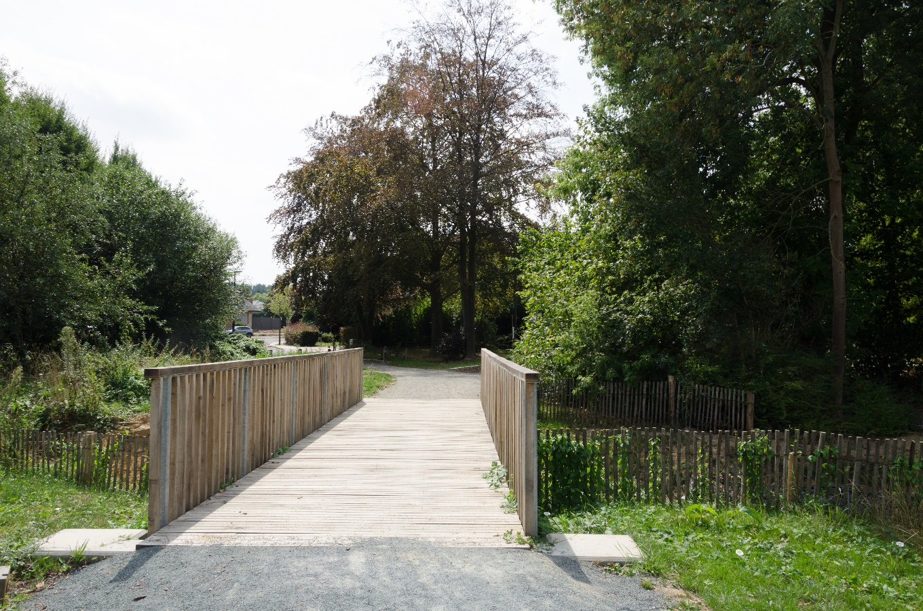
Notes:
I am kind of proud to show you the result of what our inhabitants chose for.

Slide 18
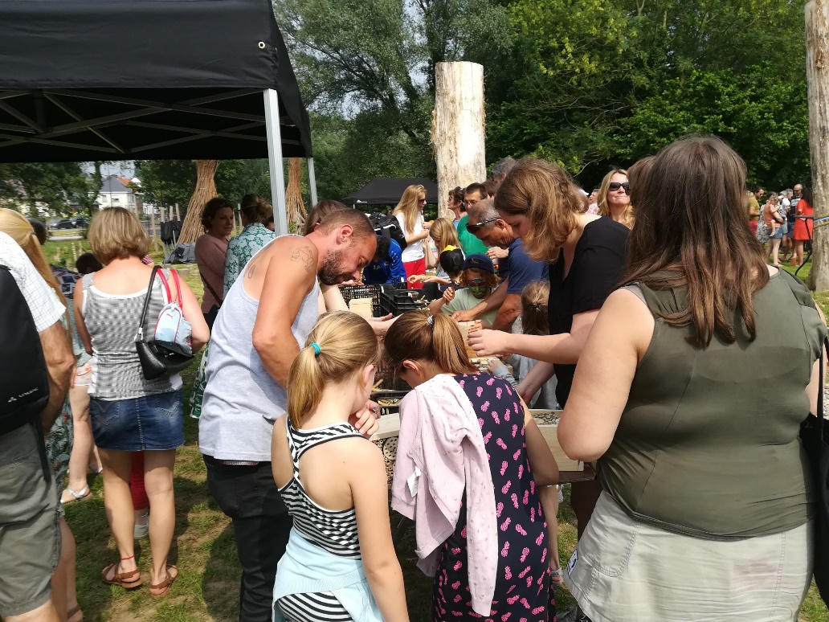
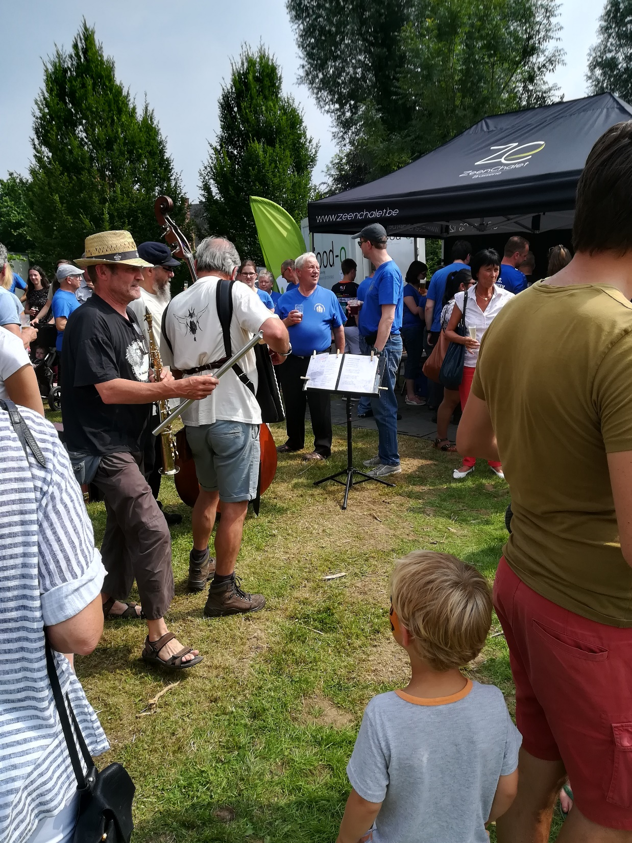
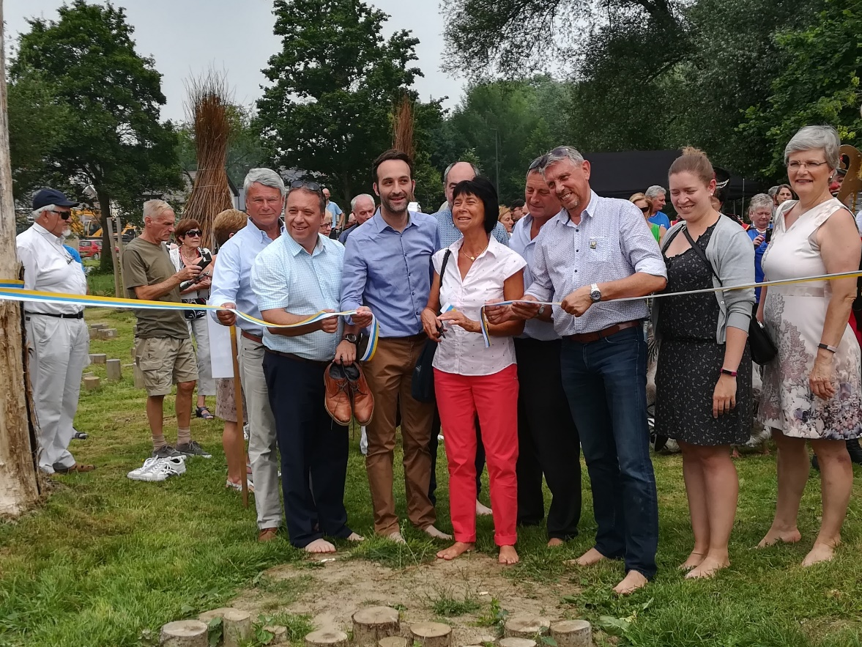
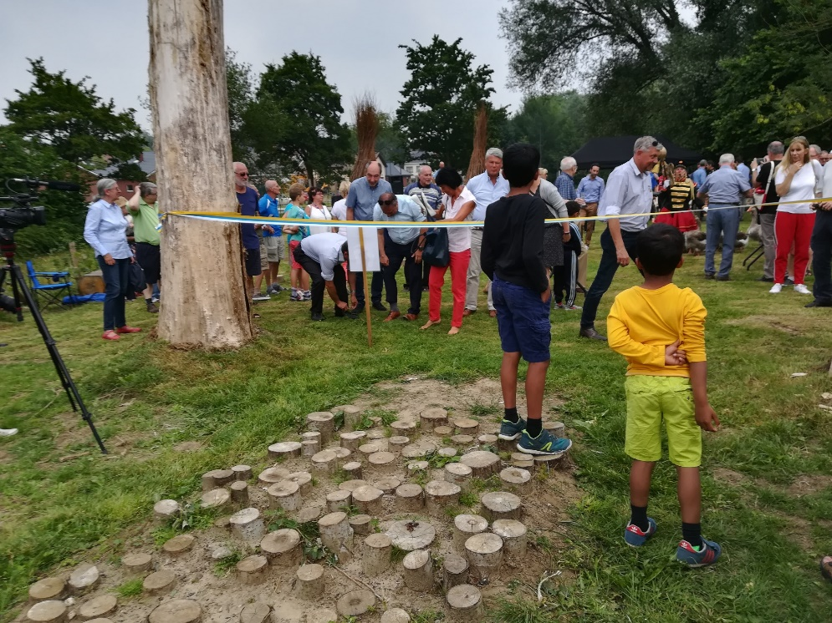
Notes:
June 2018 we opened the park officially. More than 500 inhabitants enjoyed it. They could witness how the park was a lot larger, how water retention was much better organised, how playgrounds were suitable for children, how the place was much more adapted to the climate needs nowadays, how two streets had made place for a greener environment and how there were now lots of possibilities for walking, sporting, jogging, playing, etc.

Slide 19
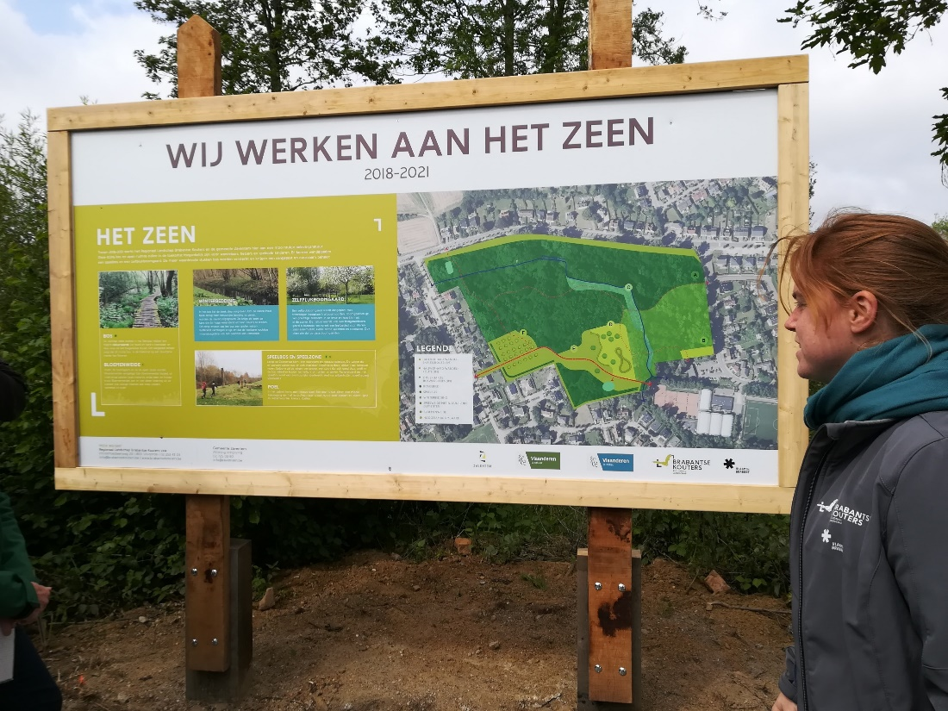
Notes:
The plan for ‘Park het Zeen’ consisted originally in five zones and two phases. Together with the municipality the Flemish Land Agency had enough means to carry out phase one and zones A to D. The success of those works and measures inspired the municipality of Zaventem to buy extra ground in Zone E and to start up the works for phase 2 also.

Slide 20
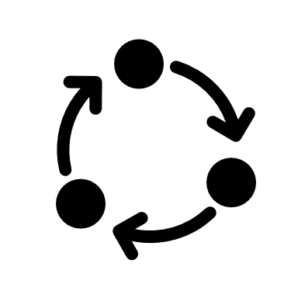

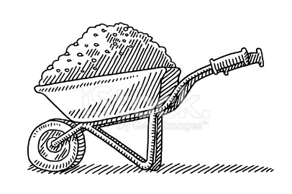
Conclusion
Strategic planning
  General measures
  Specialised input
  Expertise and knowledge
  Refined with partners
  More or less top down
Local needs and concerns
  Measures on local scale
  Detailed input
  Local experience
  Discussed with locals
  Bottom up
High social control
Lots of users
Social network gets better
People take care of ‘their park’
Form of ‘ownership’
More local satisfaction
Longer process?
Notes:
When strategic planning with general measures, specialised input, expertise and knowledge is refined with partners, you get a plan that is partly built up top down. If you confront those plans with the locally wanted measures, detailed input of inhabitants, local experience and arguments, you add the bottom up aspect and you get a plan that is supported and wanted. Also social control over the park, the use of the park and are high, People take care of ‘their’ park and the local population is usually more satisfied. Is the process longer due to the participation process? No, certainly not. Participation takes time and patience, but it makes sure less people object to the plans. If you invest enough time in participation before, you can win back that time, when you start carrying out your plans, because only few people will feel the need to object against the works.

Slide 21

Conclusion
Strategic planning
Local needs and concerns
More means
More and better communication
Better quality
Incentive for follow-upprojects
Functions as an example
Brings Europe to the people
Notes:
If there is a possibility to add international assistance to that process, we get an extra. The municipality and the Flemish Land Agency get more means of course. We can even invest more in better communication. The process improves the quality of the realisation and gives strong incentives for follow-up projects. It serves as an example and it brings Europe almost litterally to the local community.

