Slide 1
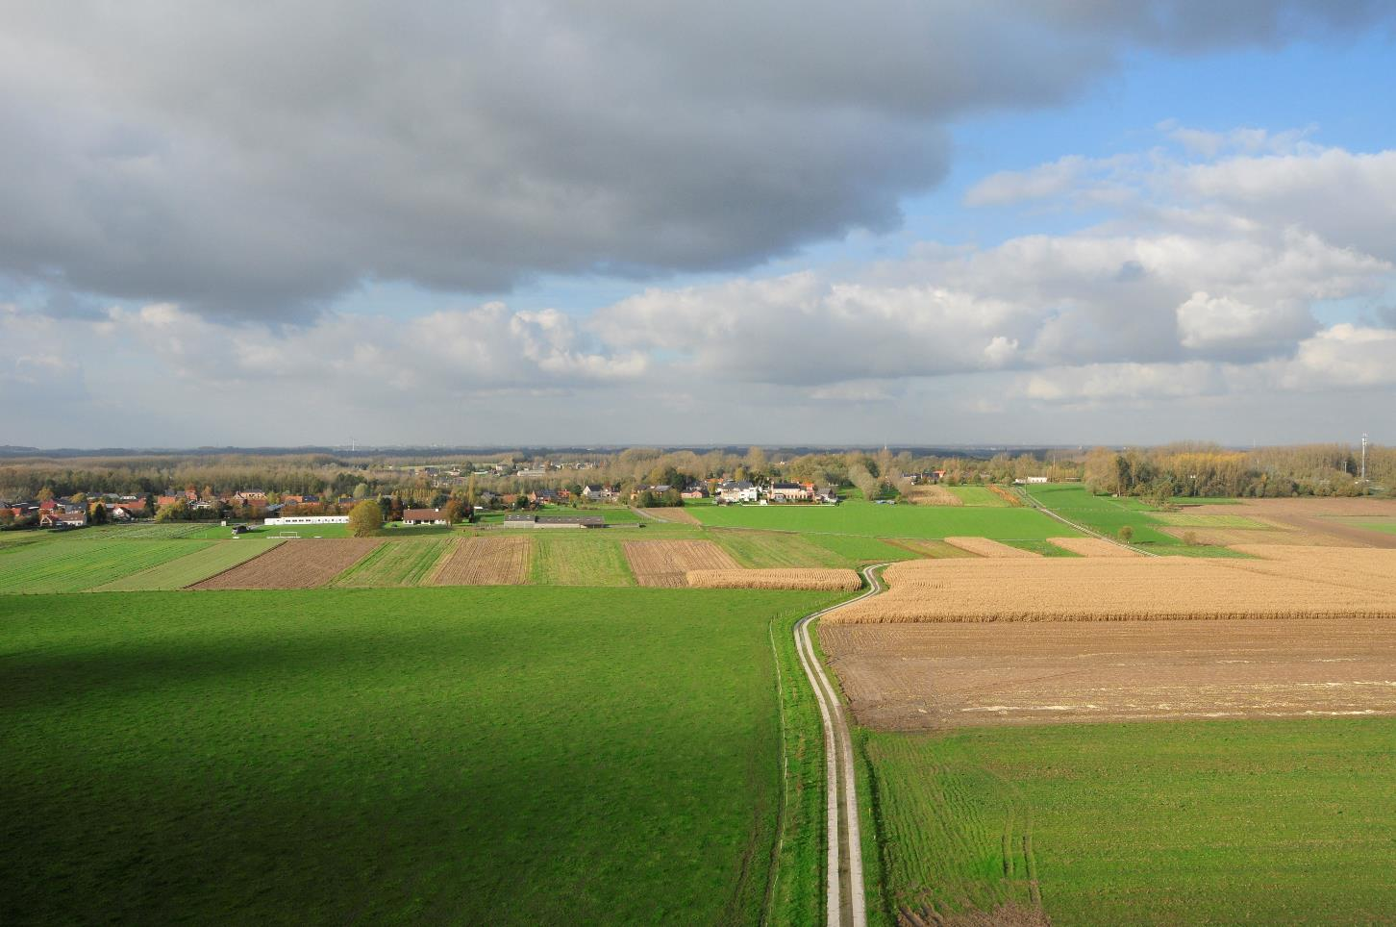


Land management in the Flemish fringe around Brussels
Green4Grey
Notes:
On behalf of the Flemish Land Agency I wish you all welcome, ladies and gentlemen. Today we planned some excursions to see the results of the Green4Grey-projects we realised in the Flemish fringe around Brussels. Maybe we should first introduce some of you a little in that Flemish fringe around Brussels.

Slide 2
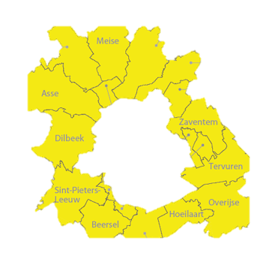
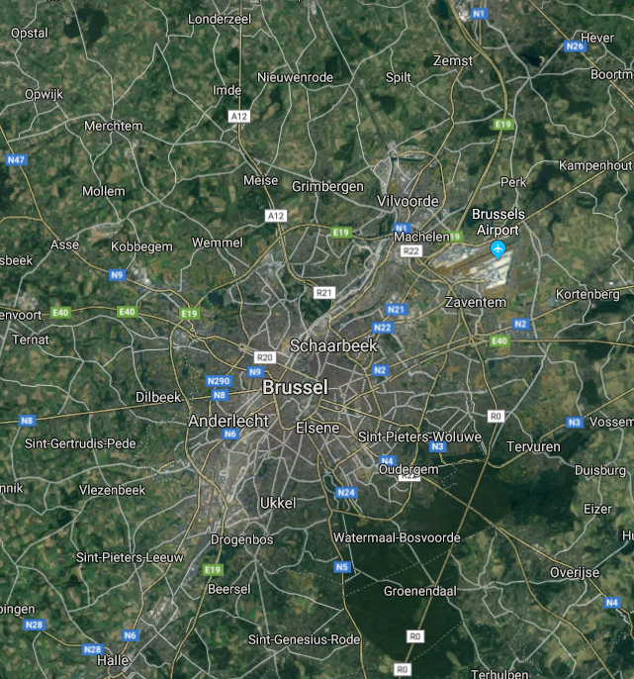
Notes:
The Flemish fringe around Brussels consists of the 19 municipalities in Flanders that surround Brussels. It is not (or not yet) a homogeneous region. There are a lot of differences. Let’s start with some numbers.

Slide 3
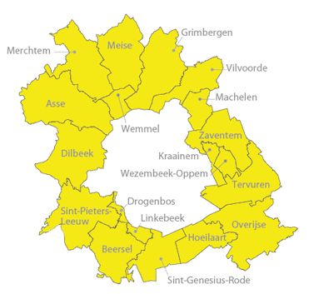
48.000 hectares
400.000 inhabitants
6 municipalities with facilities for French speaking inhabitants
16.000 hectares of agricultural land
Occupated open space: 47% (Flanders: 33%)
Hard surface: 19% (Flanders: 14%)
Drogenbos: worst in Flanders → oop 84% - hs 53%
Daily loss of open space: 2.747 m² (1 ha every 4 days)
Number one in Europe in hours lost in traffic jams

Slide 4
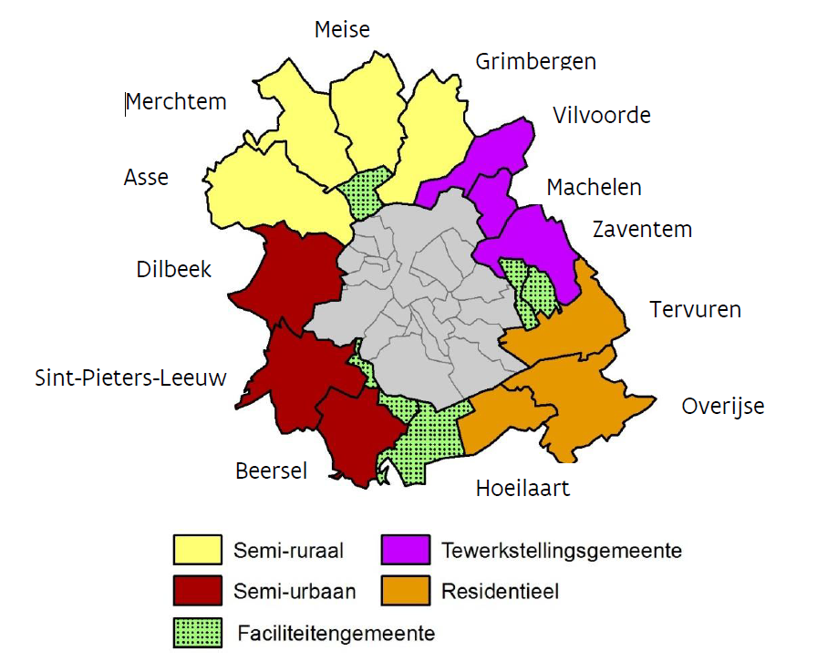
Notes:
Typical is also that the municipalities north of Brussels are still semi-rural, while those in the west are semi-urban. East of Brussels we find more densely populated, municipalities. Some of them contain a lot of industry and business, especially of course in the neighbourhood of the airport. The eastside of Brussels is under much urbanization pressure, because it links Brussels to Leuven and there is pressure from both sides. Also, some smaller municipalities very close to Brussels, like Kraainem, Wezembeek-Oppem, Drogenbos and Wemmel are very dense populated (1600 till 2200 inhabitants per square kilometer). They have also facilities for French speaking inhabitants. In the south east we find some residential municipalities. There we also find the most EU-inhabitants and expats from all over the world.

Slide 5
2010
2007
2010
Notes:
In that urbanized and urbanizing area we set our first steps in land management since 2007. We extended the process in 2010 and in 2014 the Flemish government decided the whole area should profit from land management.

Slide 6
2014
2010
2007
2014
2014
2010

Slide 7
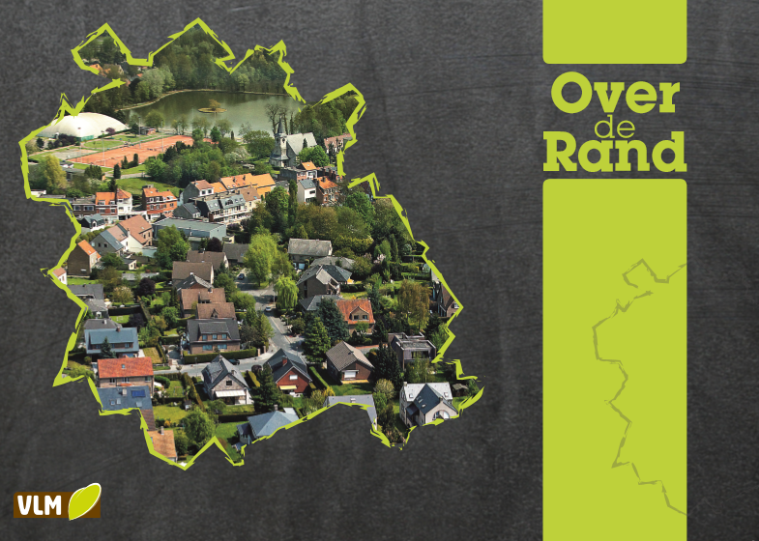
Notes:
After consulting a lot of partners, after workshops with stakeholders, brainstorms with spatial planners, more than 90 meetings with municipalities, province, Flemish departments and … not to forget … stakeholders in Brussels, we made a masterplan and wrote our guidelines.

Slide 8
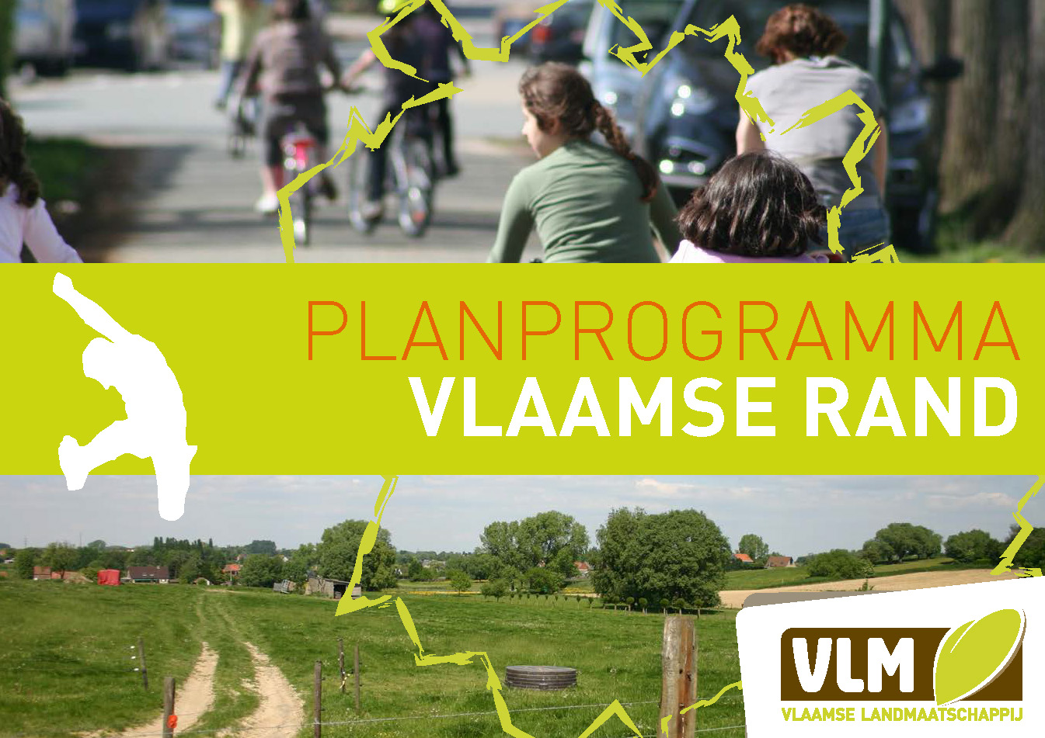
Notes:
We made a popular version of it and distributed it broadly. Our goal was and is to reorganise open space in a way all aspects get better: ecology, agriculture, heritage, nature, water retention, recreation, climate, archeology, landscape, mobility, etc.

Slide 9
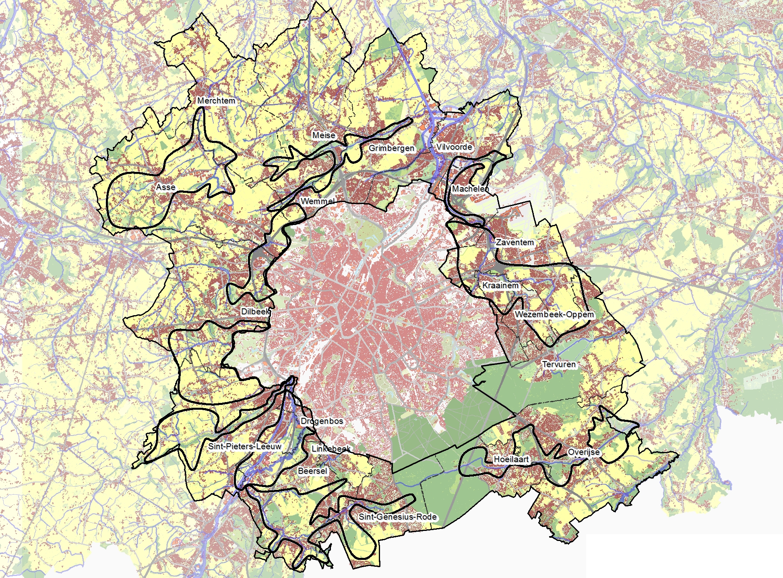
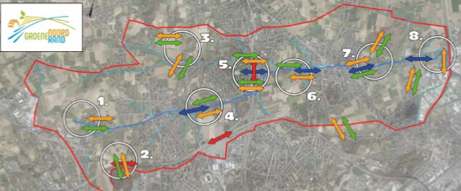
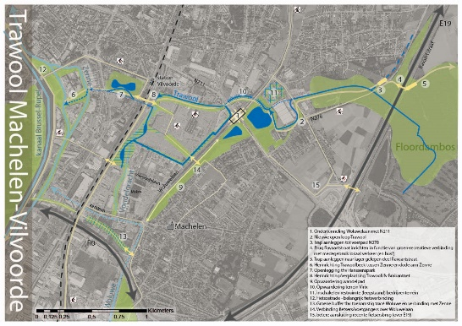
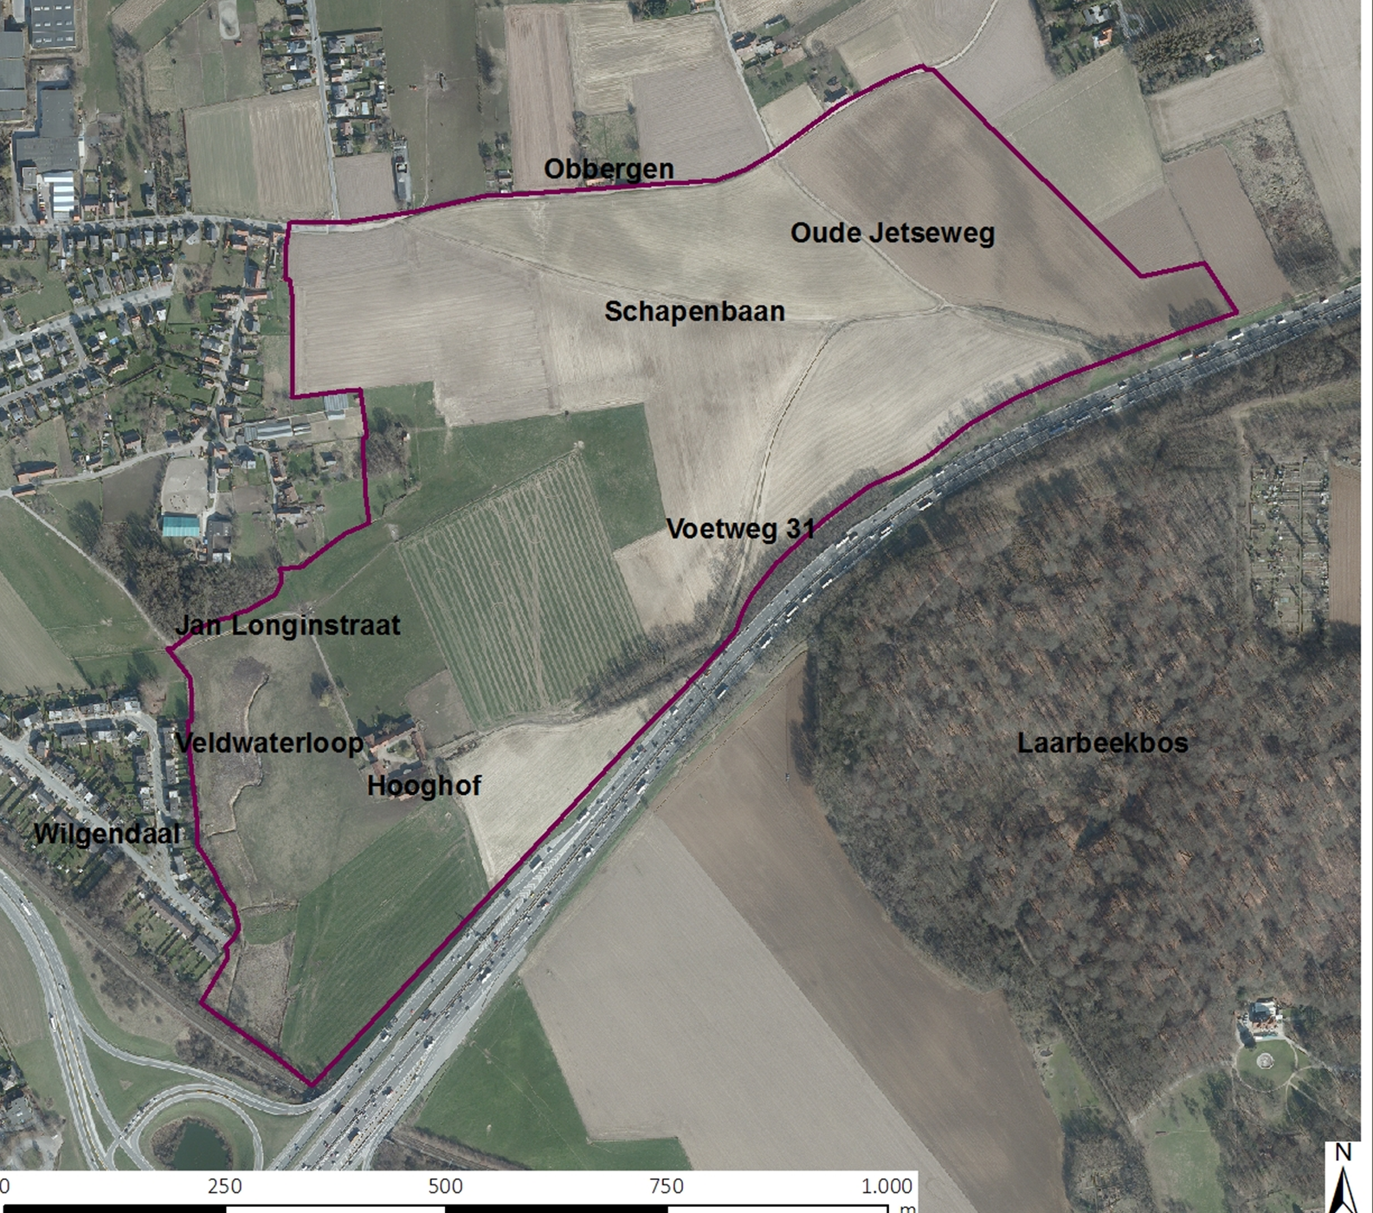
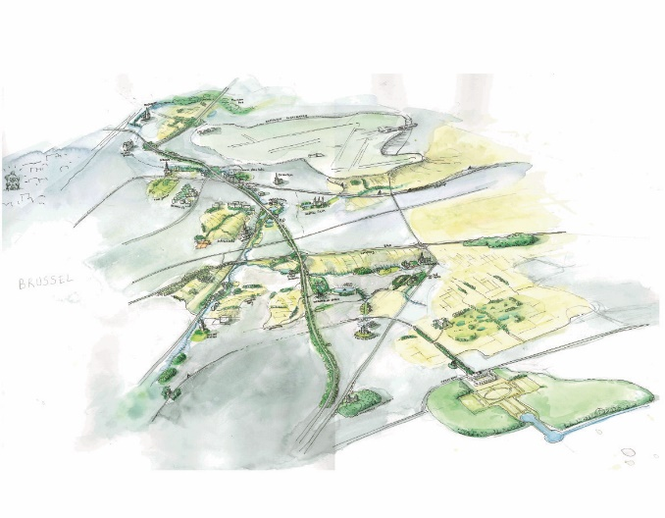
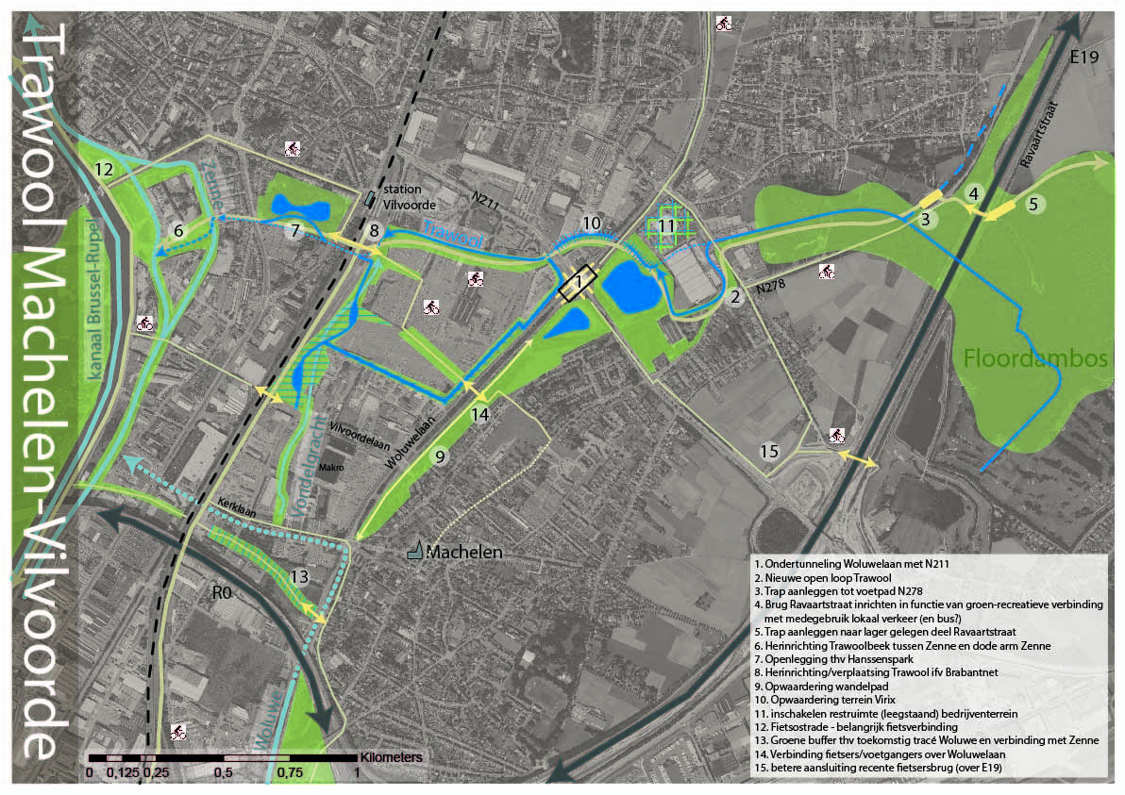
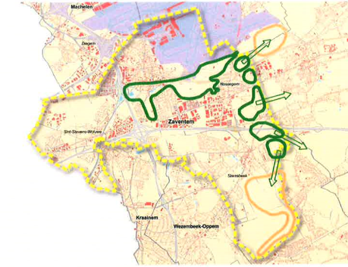
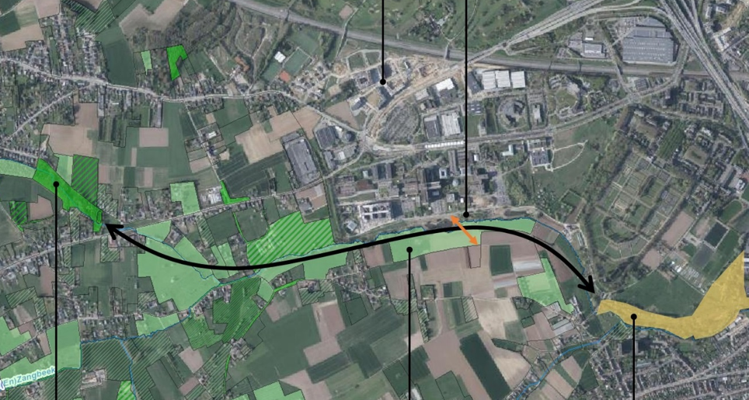
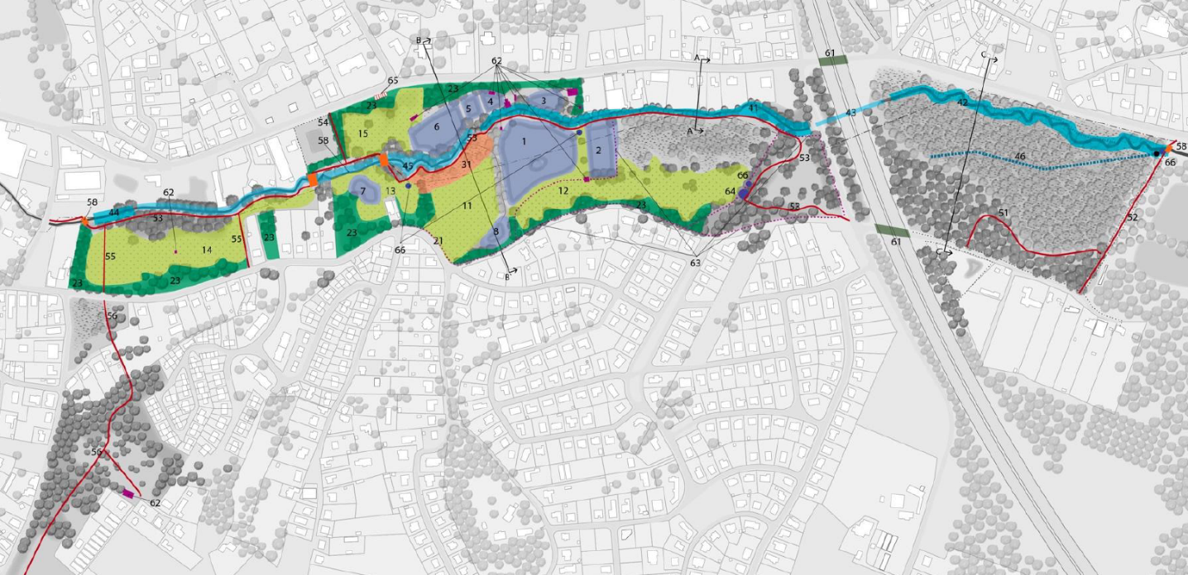
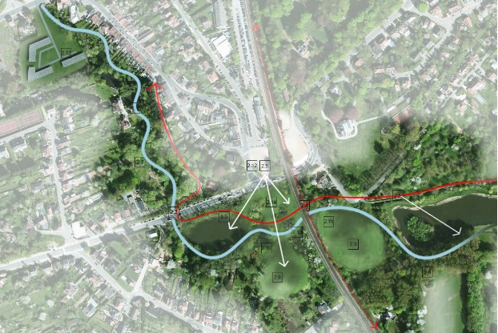
Groene Noordrand
2021 - 2027
Maalbeekvallei
2020 - 2023
Woluwe-Trawool
2021 –2024
Molenbeek-
Maalbeek
2017 - 2019
Hooghof
2019 –
2020
Openruimtenetwerk
2012 - 2019
Noskoem
2022 - 2024
Vogelzangbeek
2019 – 2025
Land van Teirlinck
2015 - 2023
IJsevallei – 2020 - 2026
Molenbeekvallei
2020 - 2026
Notes:
For the moment we have eleven projects going on in the Flemish fringe. For each of them a masterplan was being made up and almost each plan consists of several minor plans. Our capacity of full time equivalents is fully planned till 2024. By that time we will have invested about 14 million euro Flemish money in the reinforcement of open space in the Flemish fringe around Brussels. Together with the financial contribution of our partners that means we will have invested about 20 million euro in open space by that time.

Slide 10
The challenges
Renewal ring road
New shopping malls in and around Brussels
New football stadium?
New masterplan for the airport
Lots of brownfields
Speculation on new building areas
…
Notes:
Is that much? No, compared to what Flanders invests in economy, traffic, business, mobility, etc. 20 million euro over more than 10 years is in fact peanuts. And as you can see: the challenges keep the pressure on the Flemish fringe. But nevertheless we are certain that the last ten years we improved the space to live and to work and the environment thoroughly. And we surely reinforced the scarce open space left in these 19 municipalities. We hope to show you today how usefull that work can be.

Slide 11
The challenges…
Brussel is the capital of Europe and deserves projects of a European level
One third of the grounds in the Flemish fringe around Brussels is in agricultural use, but we don’t manage to grow food for a nearby market of approximately 1,5 million potential clients
The big infrastructural works that are being planned now are unique opportunities to find futureproof solutions for the mistakes we made in the past. They can give us hope on a qualitative future.
Notes:
May I leave you with these three thoughts? I wish you a pleasant day.

